Slide 1

Introduction to Operating Systems CS/COE 1550
Fall 2021
Sherif Khattab
ksm73@pitt.edu
(Some slides are from Silberschatz, Galvin and Gagne ©2013)

Slide 2
Announcements
Upcoming deadlines:
Quiz 1 and Homework 4: due 10/8
Lab 2: due on 10/18
Project 2: due on 10/22
Midterm Exam next week
10/13 for MW section and 10/14 for TuTh section
In-class, in-person, paper, closed book

Slide 3
Last Lecture …
Semaphore-based solution to the Producers-Consumers Problem

Slide 4
Muddiest Points

Slide 5
Four conditions for deadlock
Mutual exclusion
Each resource is assigned to at most one process
Hold and wait
A process holding resources can request more resources
No preemption
Previously granted resources cannot be forcibly taken away
Circular wait
There must be a circular chain of 2 or more processes where each is waiting for a resource held by the next member of the chain

Slide 6
Getting into deadlock
A
B
C
Acquire R
Acquire S
Release R
Release S
Acquire S
Acquire T
Release S
Release T
Acquire T
Acquire R
Release T
Release R
A
B
C
A
B
C
A
B
C
R
S
T
R
S
T
R
S
T
Acquire R
Acquire S
Acquire T
A
B
C
A
B
C
A
B
C
R
S
T
R
S
T
R
S
T
Deadlock!
Acquire S
Acquire T
Acquire R

Slide 7
Not getting into deadlock…
Many situations may result in deadlock (but don’t have to)
In previous example, A could release R before C requests R, resulting in no deadlock
Can we always get out of it this way?
Find ways to:
Detect deadlock and reverse it
Stop it from happening in the first place

Slide 8
Detecting deadlocks using graphs
Process holdings and requests in the table and in the graph (they’re equivalent)
Graph contains a cycle => deadlock!
Easy to pick out by looking at it (in this case)
Need to mechanically detect deadlock
Not all processes are deadlocked (A, C, F not in deadlock)
R
A
B
Process | Holds | Wants
A | R | S
B |  | T
C |  | S
D | U | S,T
E | T | V
F | W | S
G | V | U
C
S
D
T
E
F
U
V
W
G

Slide 9
Deadlock detection algorithm
General idea: try to find cycles in the resource allocation graph
Algorithm: depth-first search at each node
Mark arcs as they’re traversed
Build list of visited nodes
If node to be added is already on the list, a cycle exists!
Cycle == deadlock
Assuming one instance of each resource type
For each node N in the graph {
Set L = empty list
unmark all arcs
Traverse (N,L)
}
If no deadlock reported by now, there isn’t any
define Traverse (C,L) {
If C in L, report deadlock!
Add C to L
For each unmarked arc from C {
Mark the arc
Set A = arc destination
/* NOTE: L is a
local variable */
Traverse (A,L)
}
}

Slide 10
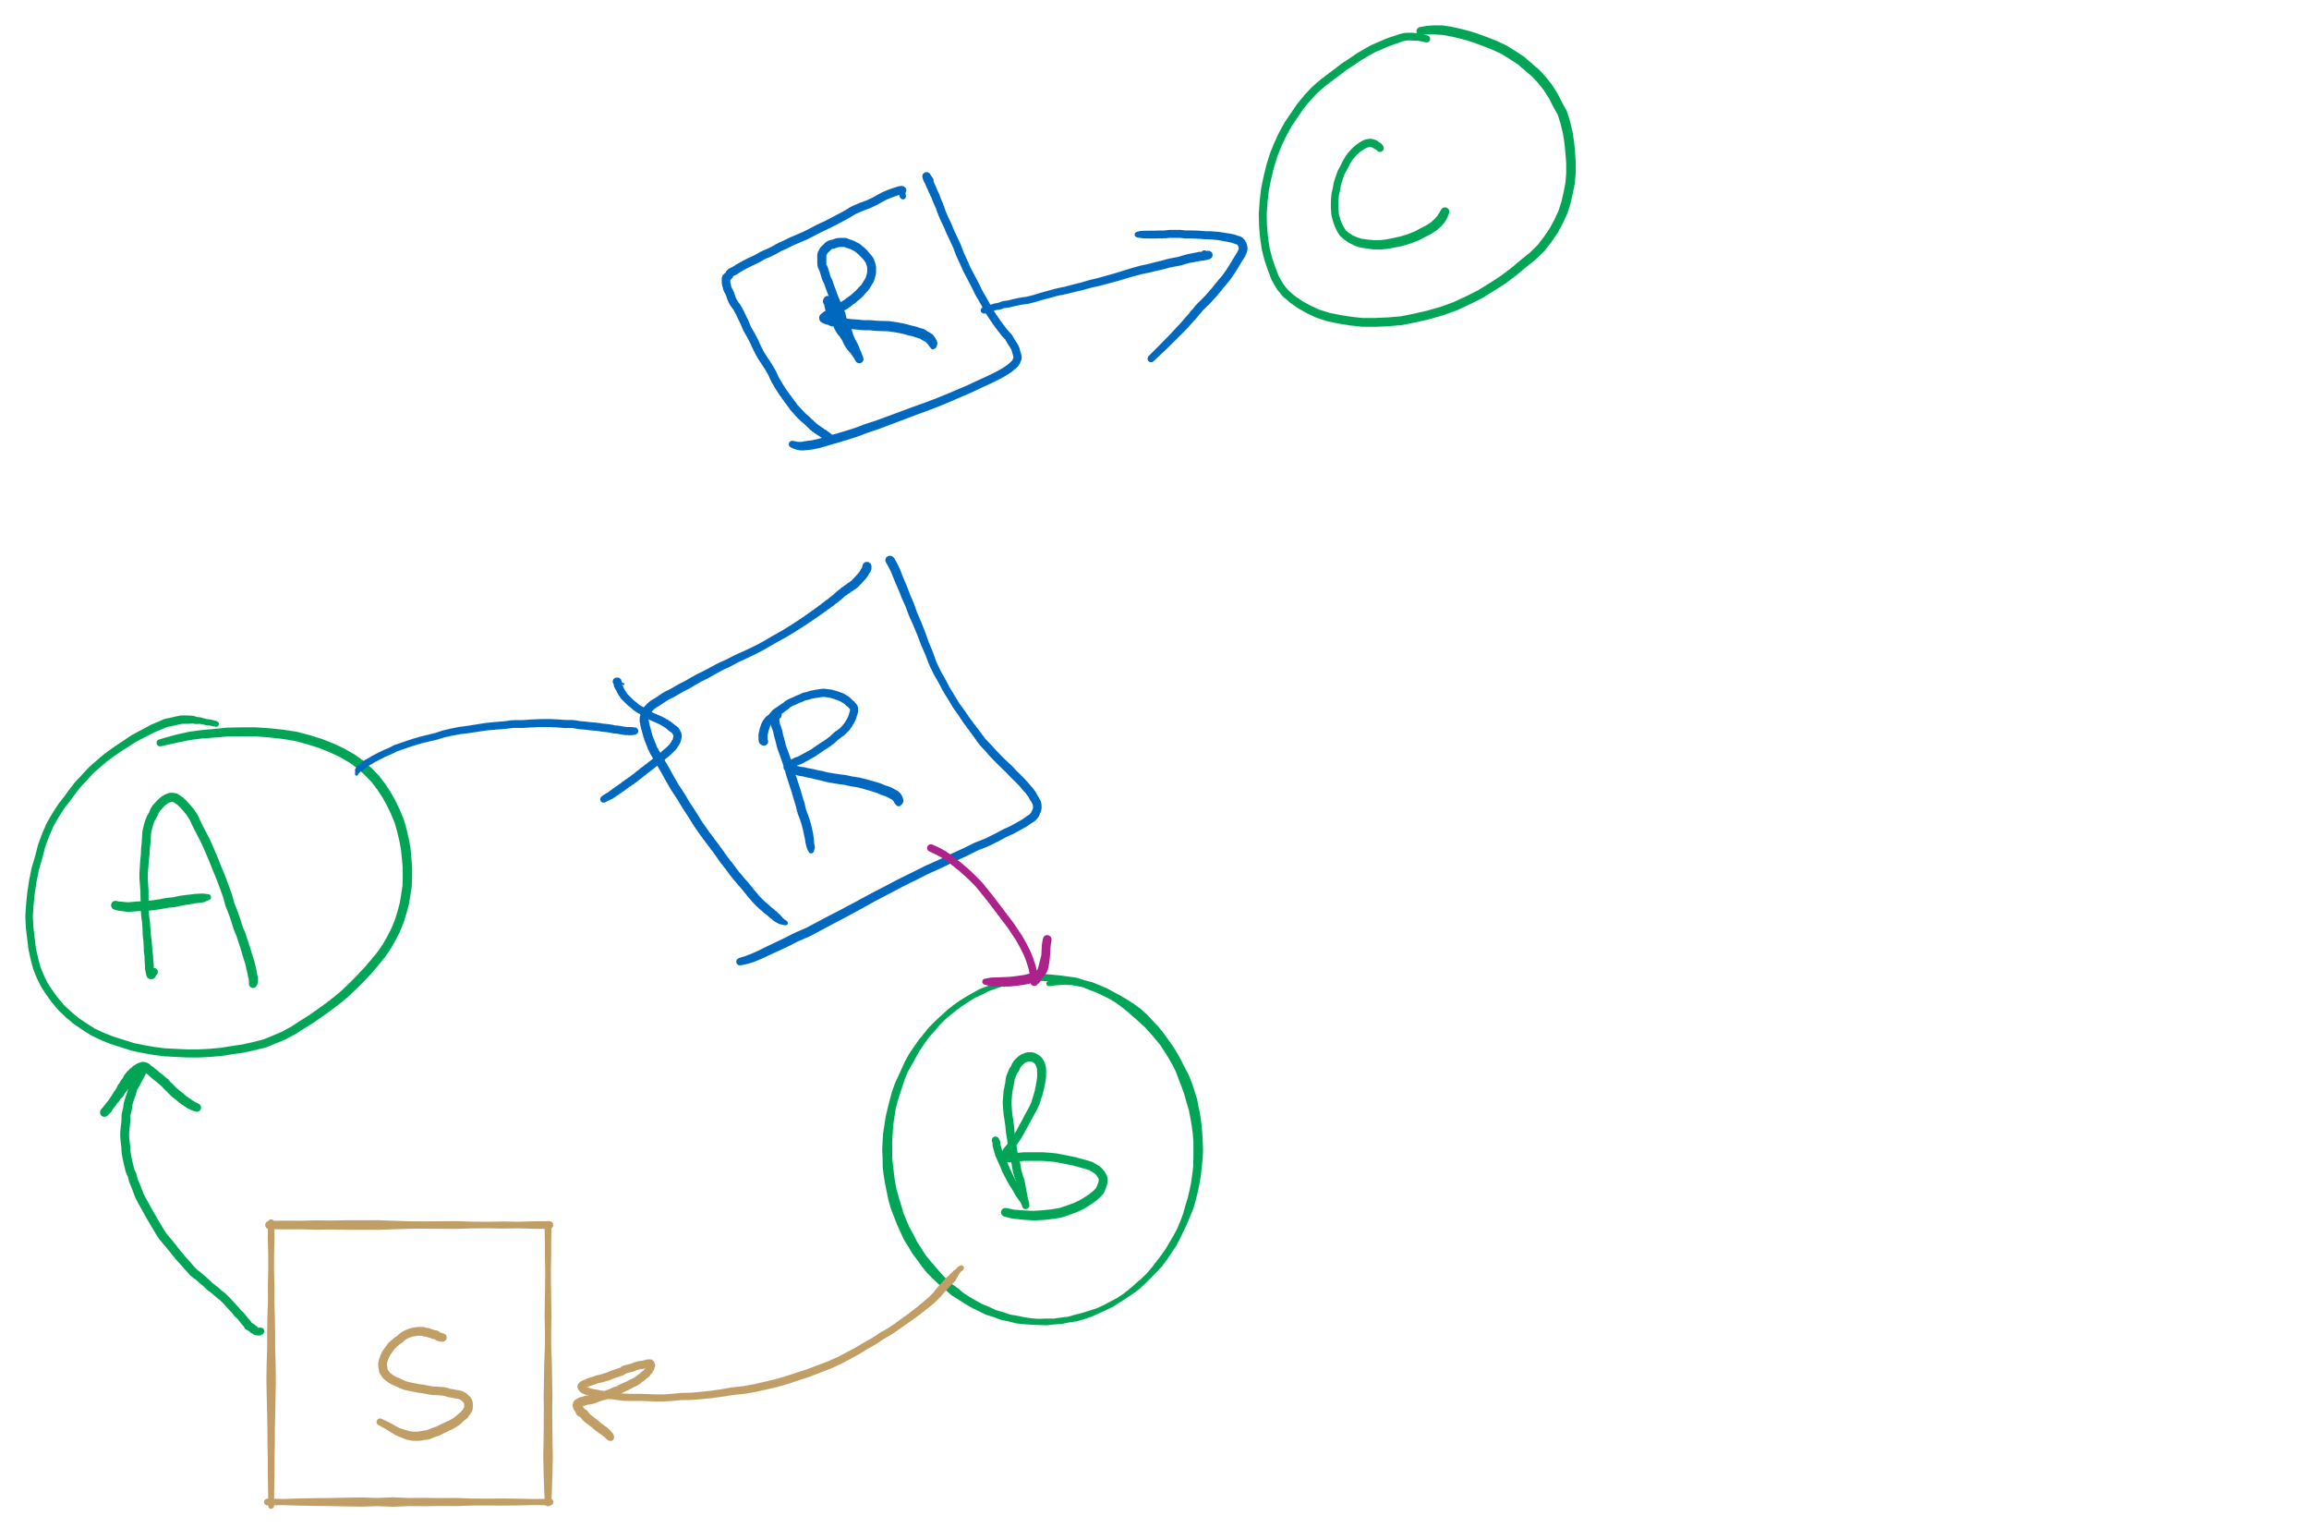
Resources with multiple instances
Previous algorithm only works if there’s one instance of each resource
If there are multiple instances of each resource, we need a different method
Track current usage and requests for each process
To detect deadlock, try to find a scenario where all processes can finish
If no such scenario exists, we have deadlock

Slide 11


Deadlock detection algorithm
current=avail;
for (j = 0; j < N; j++) {
for (k=0; k<N; k++) {
if (finished[k])
continue;
if (want[k] <= current) {
finished[k] = 1;
current += hold[k];
break;
}
}
if (k==N) {
printf “Deadlock!\n”;
// finished[k]==0 means process is in
// the deadlock
break;
}
}
 | A | B | C | D
Avail | 2 | 3 | 0 | 1
Process | A | B | C | D
1 | 0 | 3 | 0 | 0
2 | 1 | 0 | 1 | 1
3 | 0 | 2 | 1 | 0
4 | 2 | 2 | 3 | 0
Hold
Process | A | B | C | D
1 | 3 | 2 | 1 | 0
2 | 2 | 2 | 0 | 0
3 | 3 | 5 | 3 | 1
4 | 0 | 4 | 1 | 1
Want
Note: want[j], hold[j], current, avail are arrays!

Slide 12



Deadlock detection algorithm
current=avail;
for (j = 0; j < N; j++) {
for (k=0; k<N; k++) {
if (finished[k])
continue;
if (want[k] <= current) {
finished[k] = 1;
current += hold[k];
break;
}
}
if (k==N) {
printf “Deadlock!\n”;
// finished[k]==0 means process is in
// the deadlock
break;
}
}
 | A | B | C | D
current | 2 | 3 | 0 | 1
Process | A | B | C | D
1 | 0 | 3 | 0 | 0
2 | 1 | 0 | 1 | 1
3 | 0 | 2 | 1 | 0
4 | 2 | 2 | 3 | 0
Hold
Process | A | B | C | D
1 | 3 | 2 | 1 | 0
2 | 2 | 2 | 0 | 0
3 | 3 | 5 | 3 | 1
4 | 0 | 4 | 1 | 1
Want
Note: want[j], hold[j], current, avail are arrays!

Slide 13


Deadlock detection algorithm
current=avail;
for (j = 0; j < N; j++) {
for (k=0; k<N; k++) {
if (finished[k])
continue;
if (want[k] <= current) {
finished[k] = 1;
current += hold[k];
break;
}
}
if (k==N) {
printf “Deadlock!\n”;
// finished[k]==0 means process is in
// the deadlock
break;
}
}
 | A | B | C | D
current | 2 | 3 | 0 | 1
Process | A | B | C | D
1 | 0 | 3 | 0 | 0
2 | 1 | 0 | 1 | 1
3 | 0 | 2 | 1 | 0
4 | 2 | 2 | 3 | 0
Hold
Process | A | B | C | D
1 | 3 | 2 | 1 | 0
2 | 2 | 2 | 0 | 0
3 | 3 | 5 | 3 | 1
4 | 0 | 4 | 1 | 1
Want
Note: want[j], hold[j], current, avail are arrays!

Slide 14

Deadlock detection algorithm
current=avail;
for (j = 0; j < N; j++) {
for (k=0; k<N; k++) {
if (finished[k])
continue;
if (want[k] <= current) {
finished[k] = 1;
current += hold[k];
break;
}
}
if (k==N) {
printf “Deadlock!\n”;
// finished[k]==0 means process is in
// the deadlock
break;
}
}
 | A | B | C | D
current | 3 | 3 | 1 | 2
Process | A | B | C | D
1 | 0 | 3 | 0 | 0
2 | 1 | 0 | 1 | 1
3 | 0 | 2 | 1 | 0
4 | 2 | 2 | 3 | 0
Hold
Process | A | B | C | D
1 | 3 | 2 | 1 | 0
2 | 2 | 2 | 0 | 0
3 | 3 | 5 | 3 | 1
4 | 0 | 4 | 1 | 1
Want
Note: want[j], hold[j], current, avail are arrays!

Slide 15

Deadlock detection algorithm
current=avail;
for (j = 0; j < N; j++) {
for (k=0; k<N; k++) {
if (finished[k])
continue;
if (want[k] <= current) {
finished[k] = 1;
current += hold[k];
break;
}
}
if (k==N) {
printf “Deadlock!\n”;
// finished[k]==0 means process is in
// the deadlock
break;
}
}
 | A | B | C | D
current | 3 | 3 | 1 | 2
Process | A | B | C | D
1 | 0 | 3 | 0 | 0
2 | 1 | 0 | 1 | 1
3 | 0 | 2 | 1 | 0
4 | 2 | 2 | 3 | 0
Hold
Process | A | B | C | D
1 | 3 | 2 | 1 | 0
2 | 2 | 2 | 0 | 0
3 | 3 | 5 | 3 | 1
4 | 0 | 4 | 1 | 1
Want
Note: want[j], hold[j], current, avail are arrays!

Slide 16


Deadlock detection algorithm
current=avail;
for (j = 0; j < N; j++) {
for (k=0; k<N; k++) {
if (finished[k])
continue;
if (want[k] <= current) {
finished[k] = 1;
current += hold[k];
break;
}
}
if (k==N) {
printf “Deadlock!\n”;
// finished[k]==0 means process is in
// the deadlock
break;
}
}
 | A | B | C | D
current | 3 | 3 | 1 | 2
Process | A | B | C | D
1 | 0 | 3 | 0 | 0
2 | 1 | 0 | 1 | 1
3 | 0 | 2 | 1 | 0
4 | 2 | 2 | 3 | 0
Hold
Process | A | B | C | D
1 | 3 | 2 | 1 | 0
2 | 2 | 2 | 0 | 0
3 | 3 | 5 | 3 | 1
4 | 0 | 4 | 1 | 1
Want
Note: want[j], hold[j], current, avail are arrays!

Slide 17



Deadlock detection algorithm
current=avail;
for (j = 0; j < N; j++) {
for (k=0; k<N; k++) {
if (finished[k])
continue;
if (want[k] <= current) {
finished[k] = 1;
current += hold[k];
break;
}
}
if (k==N) {
printf “Deadlock!\n”;
// finished[k]==0 means process is in
// the deadlock
break;
}
}
 | A | B | C | D
current | 3 | 3 | 1 | 2
Process | A | B | C | D
1 | 0 | 3 | 0 | 0
2 | 1 | 0 | 1 | 1
3 | 0 | 2 | 1 | 0
4 | 2 | 2 | 3 | 0
Hold
Process | A | B | C | D
1 | 3 | 2 | 1 | 0
2 | 2 | 2 | 0 | 0
3 | 3 | 5 | 3 | 1
4 | 0 | 4 | 1 | 1
Want
Note: want[j], hold[j], current, avail are arrays!

Slide 18


Deadlock detection algorithm
current=avail;
for (j = 0; j < N; j++) {
for (k=0; k<N; k++) {
if (finished[k])
continue;
if (want[k] <= current) {
finished[k] = 1;
current += hold[k];
break;
}
}
if (k==N) {
printf “Deadlock!\n”;
// finished[k]==0 means process is in
// the deadlock
break;
}
}
 | A | B | C | D
current | 3 | 6 | 1 | 2
Process | A | B | C | D
1 | 0 | 3 | 0 | 0
2 | 1 | 0 | 1 | 1
3 | 0 | 2 | 1 | 0
4 | 2 | 2 | 3 | 0
Hold
Process | A | B | C | D
1 | 3 | 2 | 1 | 0
2 | 2 | 2 | 0 | 0
3 | 3 | 5 | 3 | 1
4 | 0 | 4 | 1 | 1
Want
Note: want[j], hold[j], current, avail are arrays!

Slide 19




Deadlock detection algorithm
current=avail;
for (j = 0; j < N; j++) {
for (k=0; k<N; k++) {
if (finished[k])
continue;
if (want[k] <= current) {
finished[k] = 1;
current += hold[k];
break;
}
}
if (k==N) {
printf “Deadlock!\n”;
// finished[k]==0 means process is in
// the deadlock
break;
}
}
 | A | B | C | D
current | 3 | 6 | 1 | 2
Process | A | B | C | D
1 | 0 | 3 | 0 | 0
2 | 1 | 0 | 1 | 1
3 | 0 | 2 | 1 | 0
4 | 2 | 2 | 3 | 0
Hold
Process | A | B | C | D
1 | 3 | 2 | 1 | 0
2 | 2 | 2 | 0 | 0
3 | 3 | 5 | 3 | 1
4 | 0 | 4 | 1 | 1
Want
Note: want[j], hold[j], current, avail are arrays!

Slide 20


Deadlock detection algorithm
current=avail;
for (j = 0; j < N; j++) {
for (k=0; k<N; k++) {
if (finished[k])
continue;
if (want[k] <= current) {
finished[k] = 1;
current += hold[k];
break;
}
}
if (k==N) {
printf “Deadlock!\n”;
// finished[k]==0 means process is in
// the deadlock
break;
}
}
 | A | B | C | D
current | 5 | 8 | 4 | 2
Process | A | B | C | D
1 | 0 | 3 | 0 | 0
2 | 1 | 0 | 1 | 1
3 | 0 | 2 | 1 | 0
4 | 2 | 2 | 3 | 0
Hold
Process | A | B | C | D
1 | 3 | 2 | 1 | 0
2 | 2 | 2 | 0 | 0
3 | 3 | 5 | 3 | 1
4 | 0 | 4 | 1 | 1
Want
Note: want[j], hold[j], current, avail are arrays!

Slide 21






Deadlock detection algorithm
current=avail;
for (j = 0; j < N; j++) {
for (k=0; k<N; k++) {
if (finished[k])
continue;
if (want[k] <= current) {
finished[k] = 1;
current += hold[k];
break;
}
}
if (k==N) {
printf “Deadlock!\n”;
// finished[k]==0 means process is in
// the deadlock
break;
}
}
 | A | B | C | D
current | 5 | 8 | 4 | 2
Process | A | B | C | D
1 | 0 | 3 | 0 | 0
2 | 1 | 0 | 1 | 1
3 | 0 | 2 | 1 | 0
4 | 2 | 2 | 3 | 0
Hold
Process | A | B | C | D
1 | 3 | 2 | 1 | 0
2 | 2 | 2 | 0 | 0
3 | 3 | 5 | 3 | 1
4 | 0 | 4 | 1 | 1
Want
Note: want[j], hold[j], current, avail are arrays!

Slide 22


Deadlock detection algorithm
current=avail;
for (j = 0; j < N; j++) {
for (k=0; k<N; k++) {
if (finished[k])
continue;
if (want[k] <= current) {
finished[k] = 1;
current += hold[k];
break;
}
}
if (k==N) {
printf “Deadlock!\n”;
// finished[k]==0 means process is in
// the deadlock
break;
}
}
 | A | B | C | D
current | 5 | 10 | 5 | 2
Process | A | B | C | D
1 | 0 | 3 | 0 | 0
2 | 1 | 0 | 1 | 1
3 | 0 | 2 | 1 | 0
4 | 2 | 2 | 3 | 0
Hold
Process | A | B | C | D
1 | 3 | 2 | 1 | 0
2 | 2 | 2 | 0 | 0
3 | 3 | 5 | 3 | 1
4 | 0 | 4 | 1 | 1
Want
Note: want[j], hold[j], current, avail are arrays!

Slide 23





Deadlock detection algorithm
current=avail;
for (j = 0; j < N; j++) {
for (k=0; k<N; k++) {
if (finished[k])
continue;
if (want[k] <= current) {
finished[k] = 1;
current += hold[k];
break;
}
}
if (k==N) {
printf “Deadlock!\n”;
// finished[k]==0 means process is in
// the deadlock
break;
}
}
 | A | B | C | D
current | 5 | 10 | 5 | 2
Process | A | B | C | D
1 | 0 | 3 | 0 | 0
2 | 1 | 0 | 1 | 1
3 | 0 | 2 | 1 | 0
4 | 2 | 2 | 3 | 0
Hold
Process | A | B | C | D
1 | 3 | 2 | 1 | 0
2 | 2 | 2 | 0 | 0
3 | 3 | 5 | 3 | 1
4 | 0 | 4 | 1 | 1
Want
Note: want[j], hold[j], current, avail are arrays!

Slide 24
Condition variables in monitors
Problem: how can a process wait inside a monitor?
Can’t simply sleep: there’s no way for anyone else to enter
Solution: use a condition variable
Condition variables support two operations
Wait(): suspend this process until signaled
Signal(): wake up exactly one process waiting on this condition variable
If no process is waiting, signal has no effect
Signals on condition variables aren’t “saved up”
Different from semaphores!
Condition variables are only usable within monitors
Process must be in monitor to signal on a condition variable

Slide 25
Locks & condition variables
Monitors require native language support
What if native support is not there (e.g., in C)?
Provide monitor support using special data types and procedures
Locks (Acquire(), Release())
Condition variables (Wait(), Signal())
Lock usage
Acquiring a lock == entering a monitor
Releasing a lock == leaving a monitor
Condition variable usage
Each condition variable is associated with exactly one lock
Lock must be held to use condition variable
Waiting on a condition variable releases the lock implicitly and reacquires the lock upon returning

Slide 26
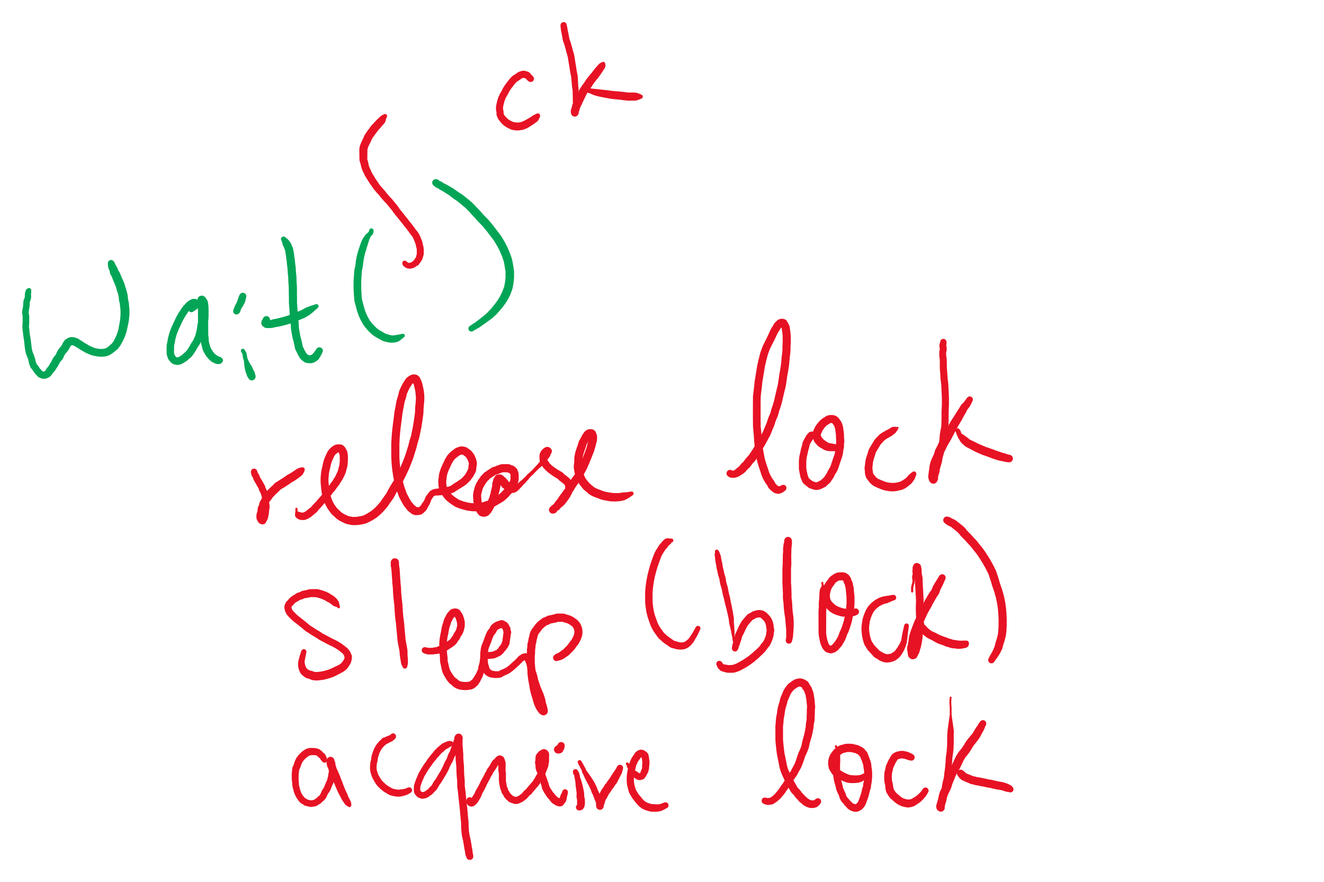


The three steps of the wait() operation

Slide 27
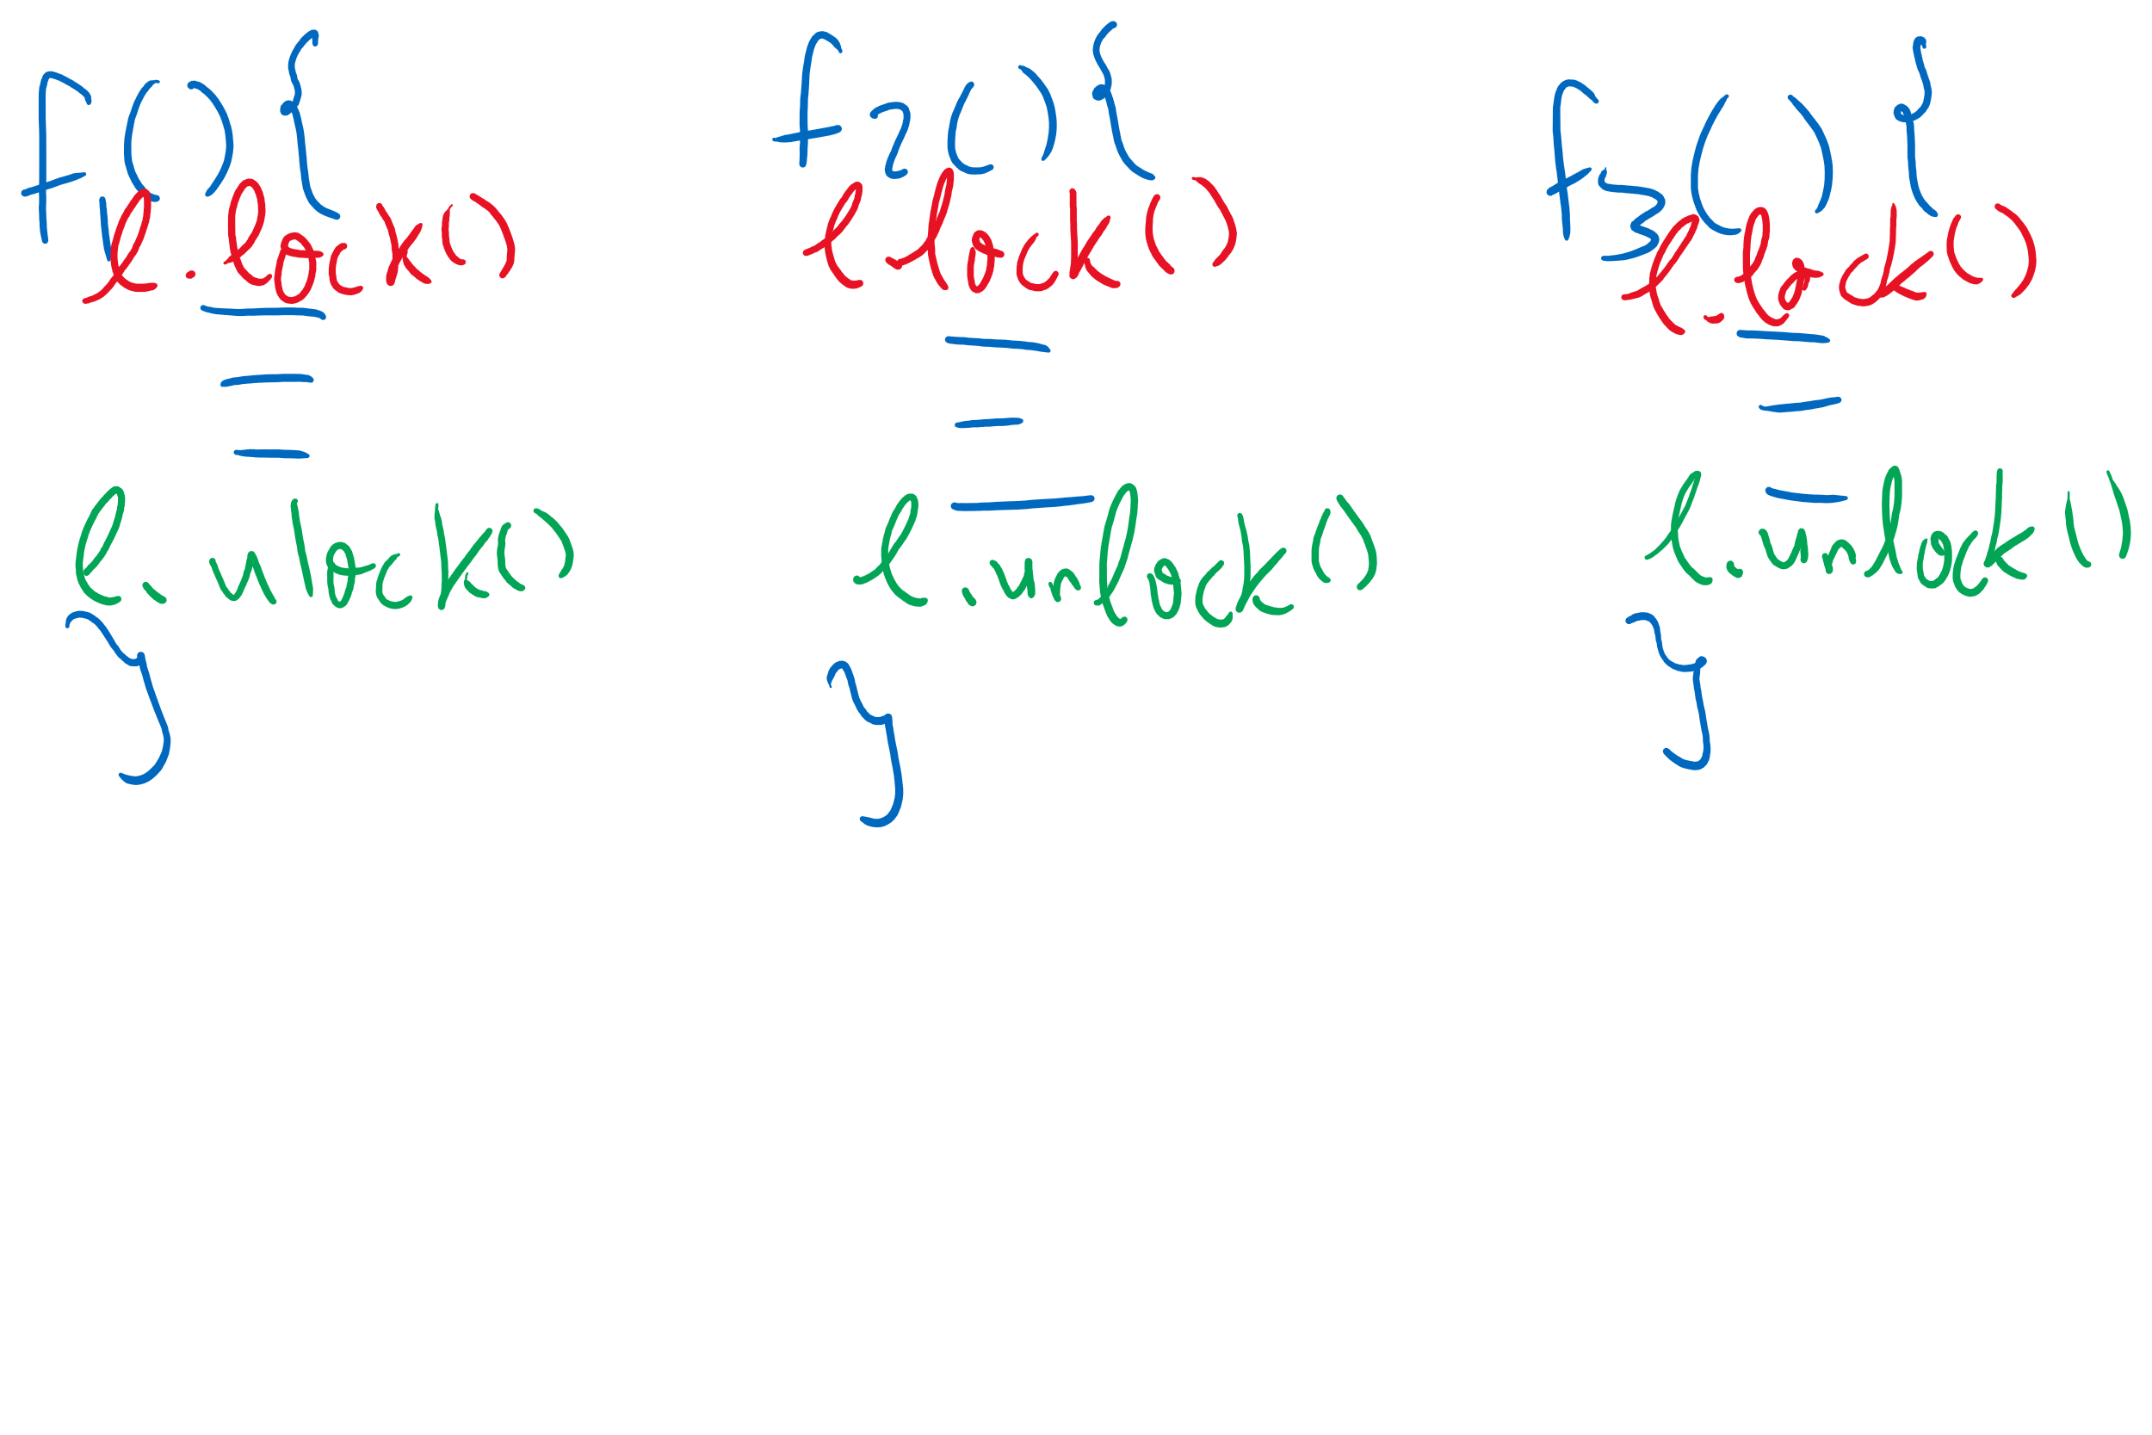
Adding Monitors in C

Slide 28
Monitor semantics
Question: which process gets the monitor after Signal()?
Problem: P signals on condition variable X, waking Q
Both can’t be active in the monitor at the same time
Which one continues first?
Mesa semantics
Signaling process (P) continues first
Q resumes when P leaves the monitor
Seems more logical: why suspend P when it signals?
Hoare semantics
Awakened process (Q) continues first
P resumes when Q leaves the monitor
May be better: condition that Q wanted may no longer hold when P leaves the monitor

Slide 29
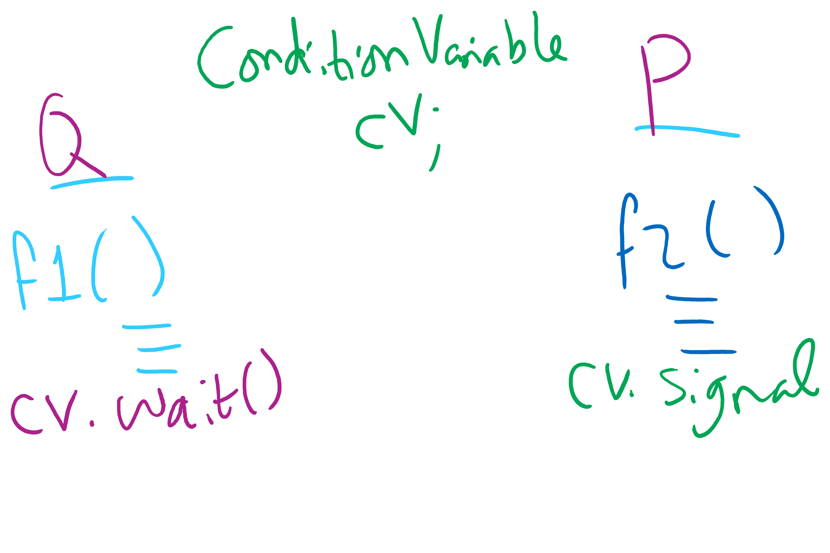
Signaling and Signaled Processes

Slide 30
Condition Variables wait()
Use a while loop around the wait()
While(some condition)
condvar.wait();
Why??
Think Mesa semantics!
Spurious wakeups

Slide 31
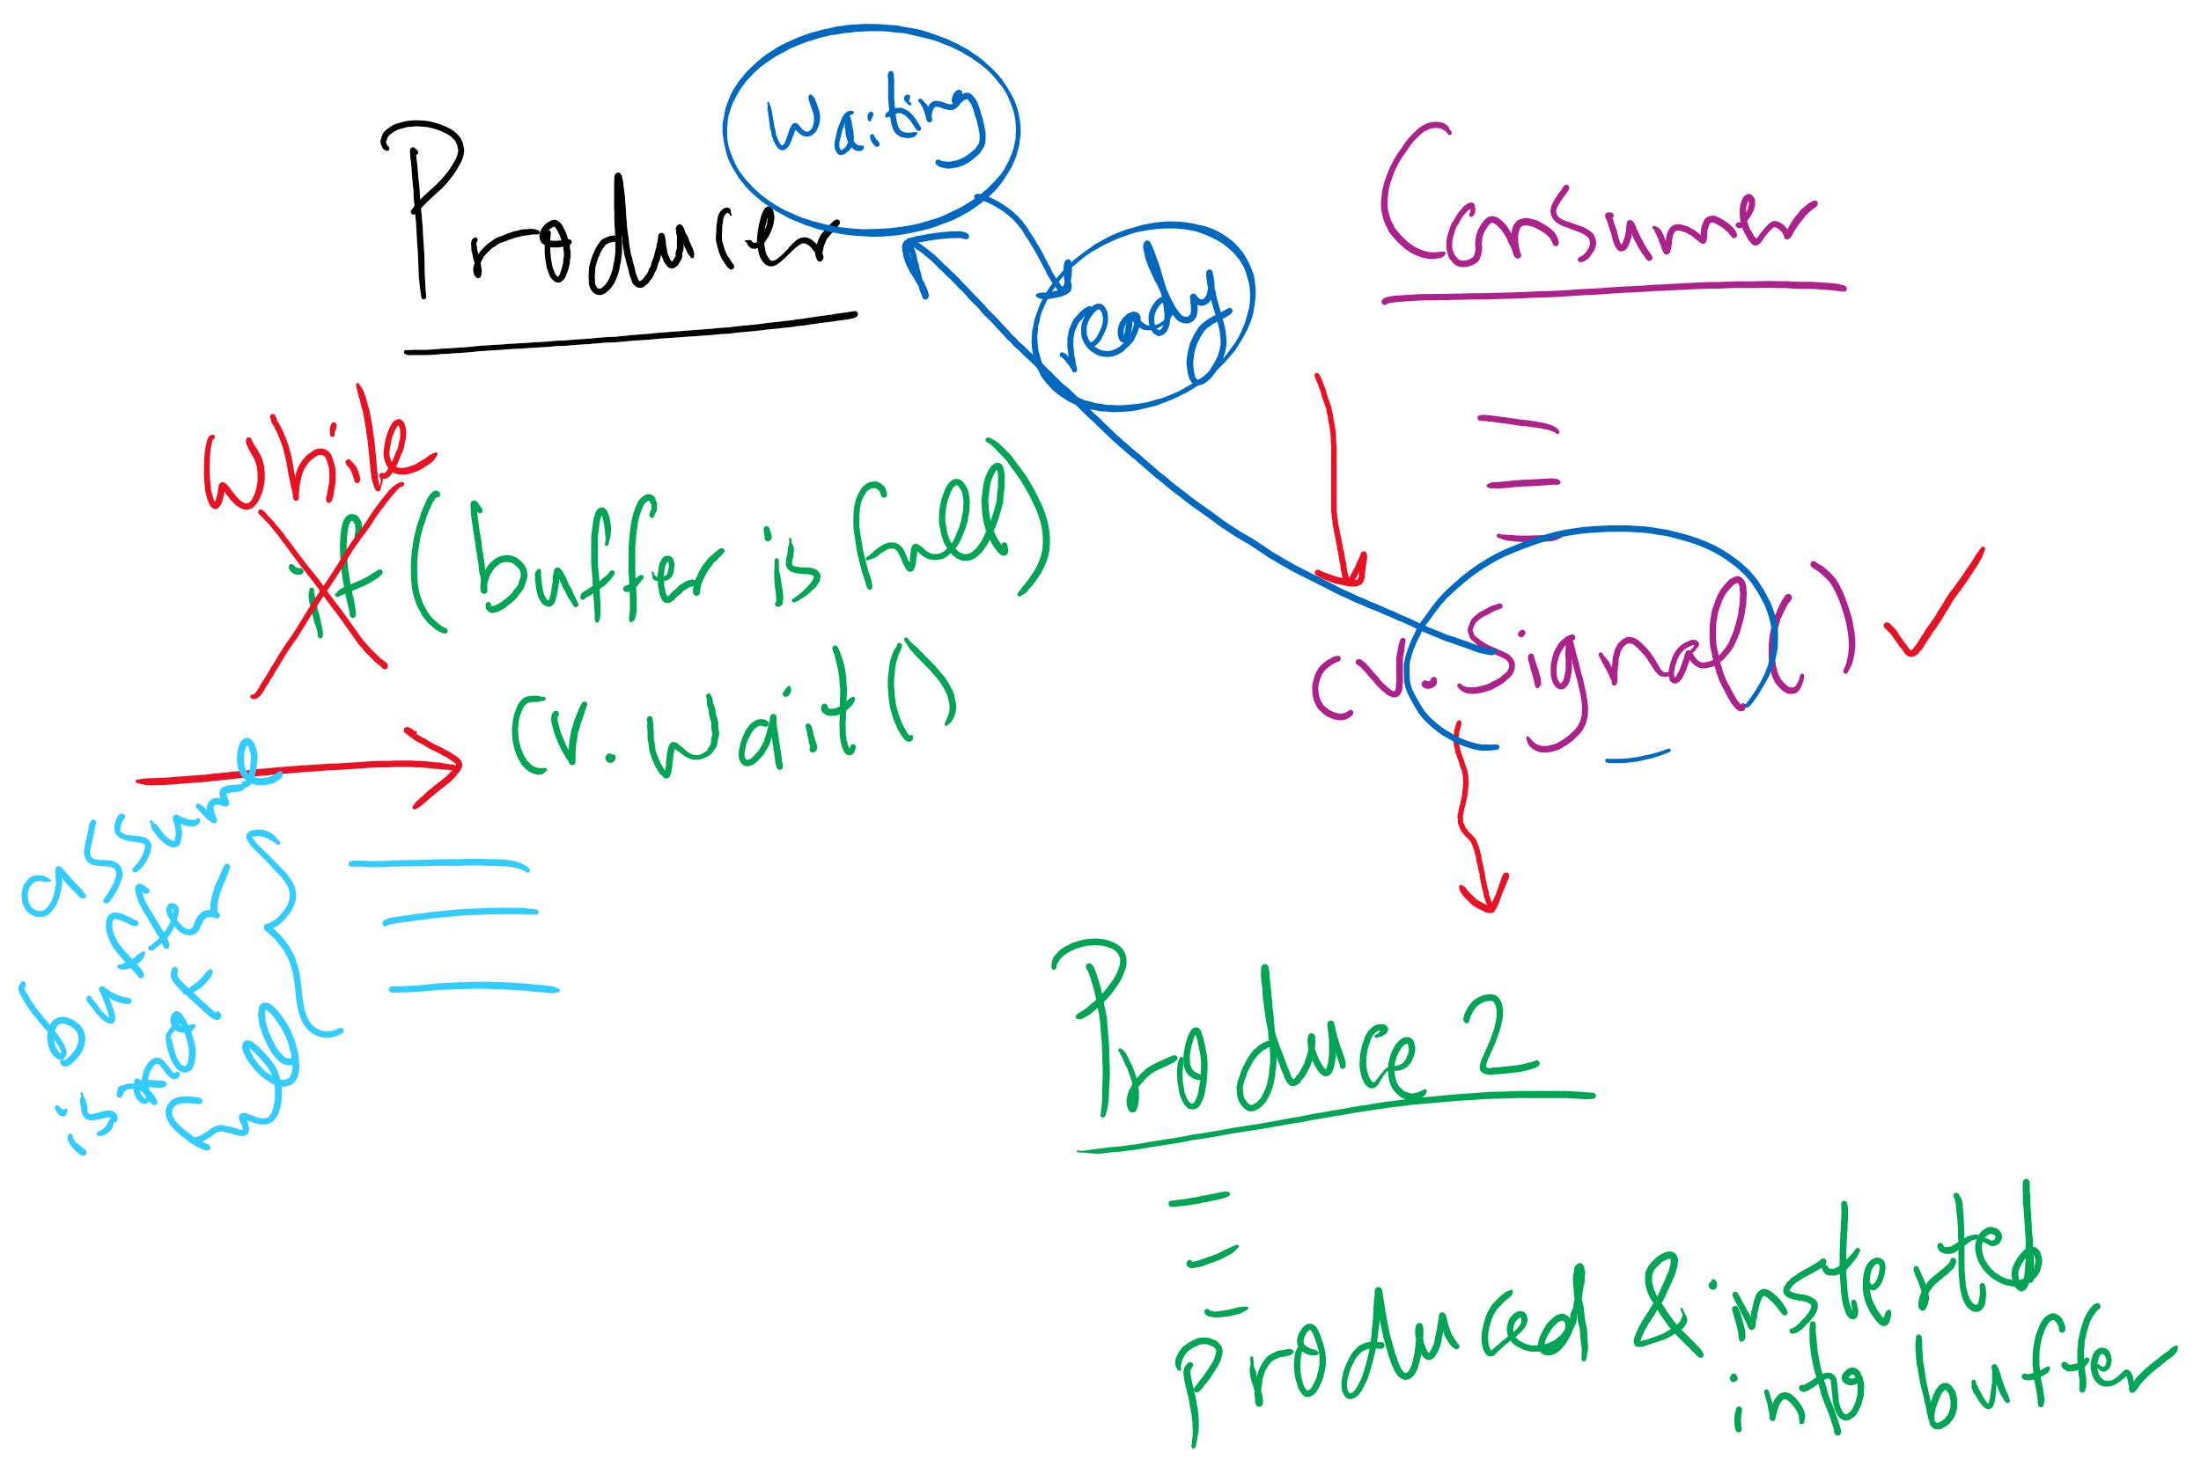
Using while instead of if with wait()

Slide 32
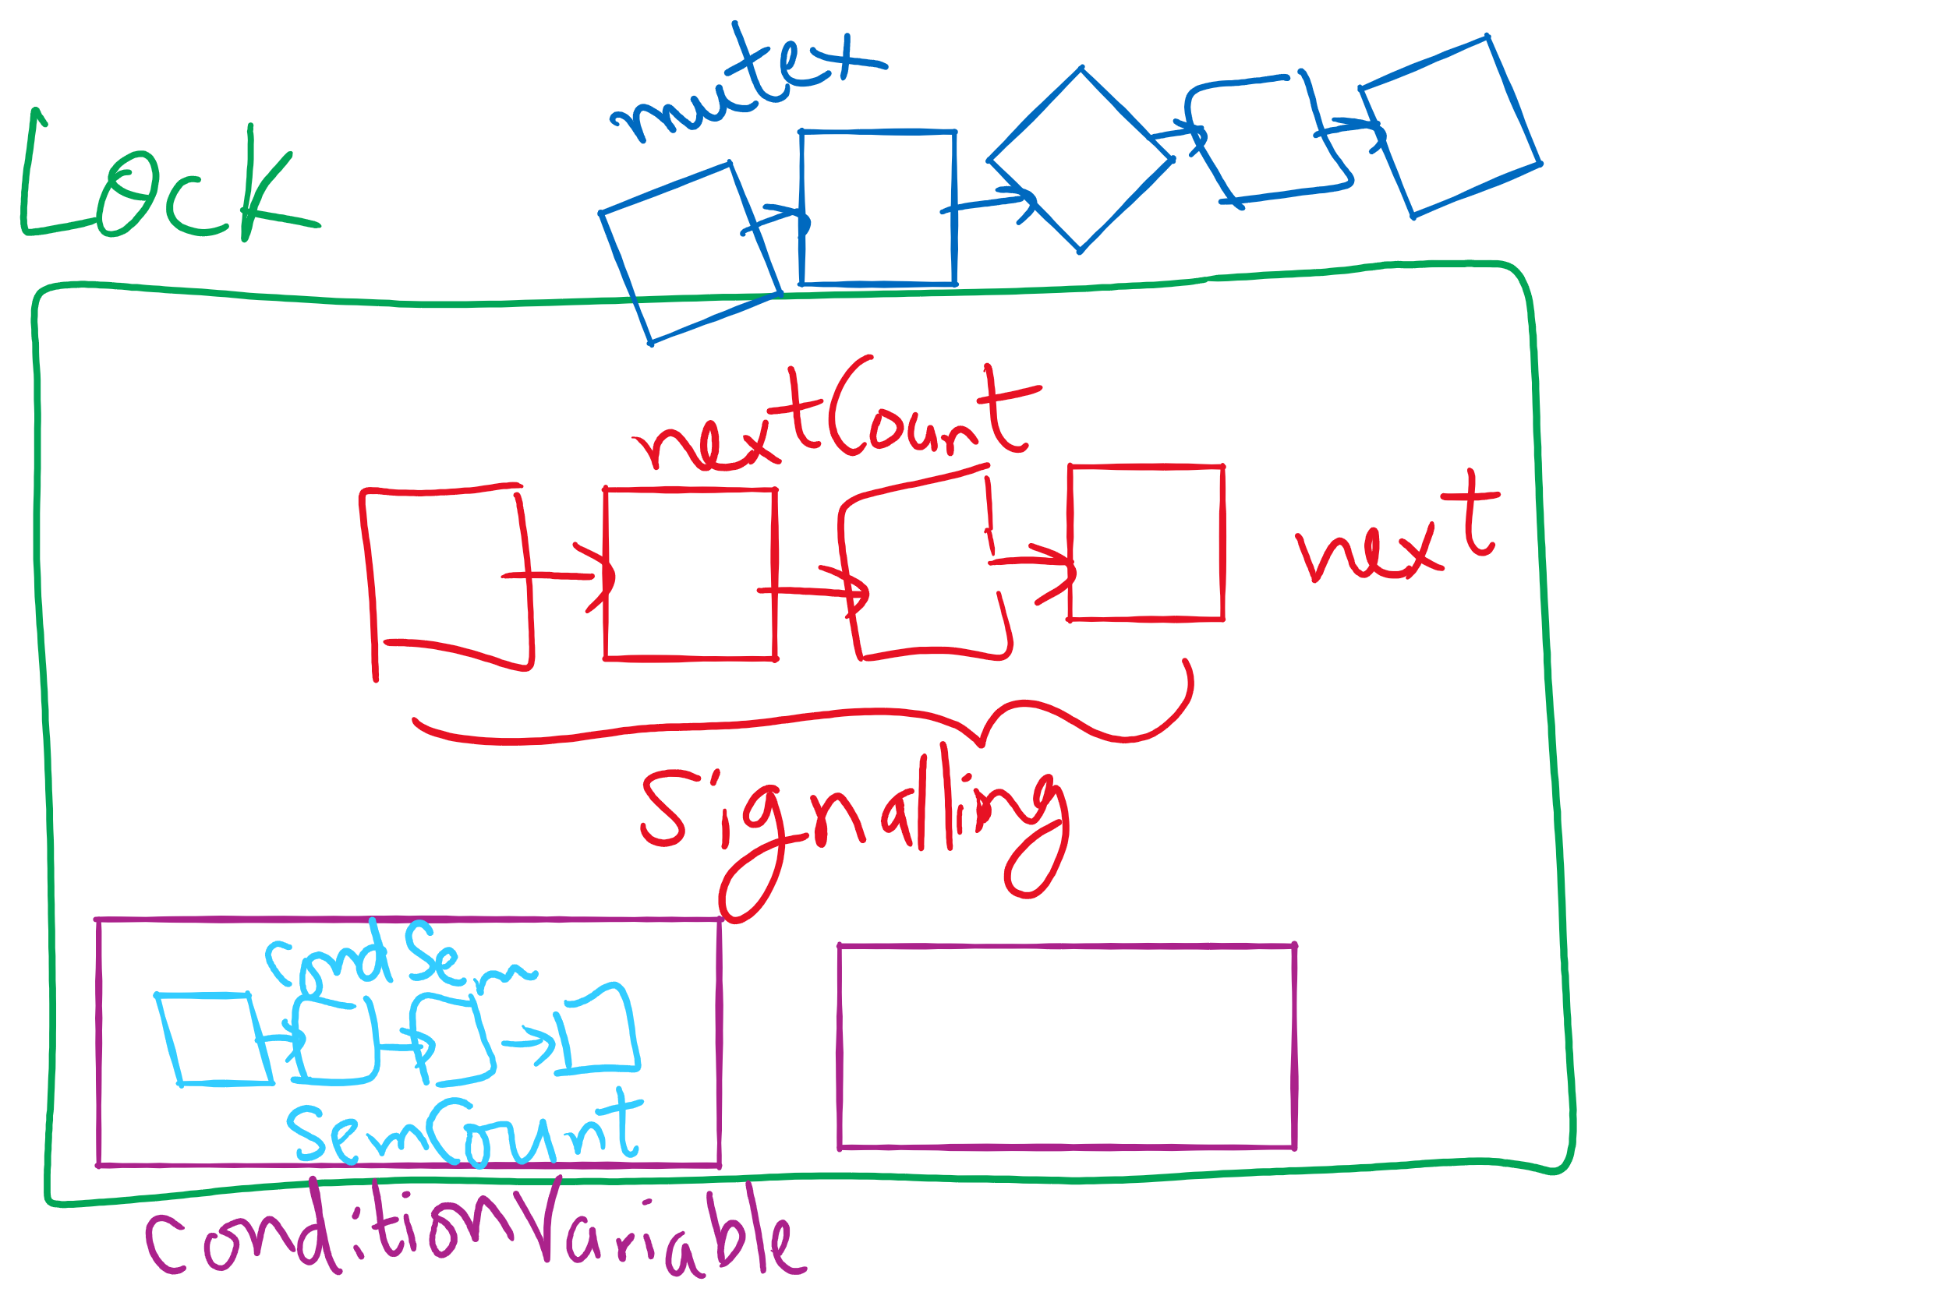
Lock and Condition Variable Implementation

Slide 33
Implementing locks with semaphores
Use mutex to ensure exclusion within the lock bounds
Use next to give lock to processes with a higher priority (why?)
nextCount indicates whether there are any higher priority waiters
class Lock {
Semaphore mutex(1);
Semaphore next(0);
int nextCount = 0;
};
Lock::Acquire()
{
mutex.down();
}
Lock::Release()
{
if (nextCount > 0)
next.up();
else
mutex.up();
}

Slide 34
Implementing condition variables
Are these Hoare or Mesa semantics?
Can there be multiple condition variables for a single Lock?
class Condition {
Lock *lock;
Semaphore condSem(0);
int semCount = 0;
};
Condition::Signal ()
{
if (semCount > 0) {
lock->nextCount += 1;
condSem.up ();
lock->next.down ();
lock->nextCount -= 1;
}
}
Condition::Wait ()
{
semCount += 1;
if (lock->nextCount > 0)
lock->next.up();
else
lock->mutex.up();
condSem.down ();
semCount -= 1;
}

Slide 35
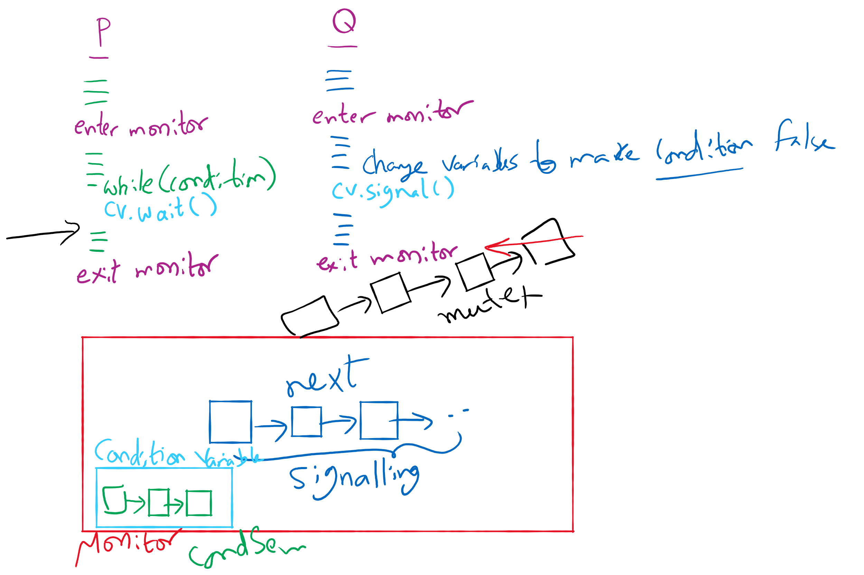
Process Synchronization inside Monitors

Slide 36
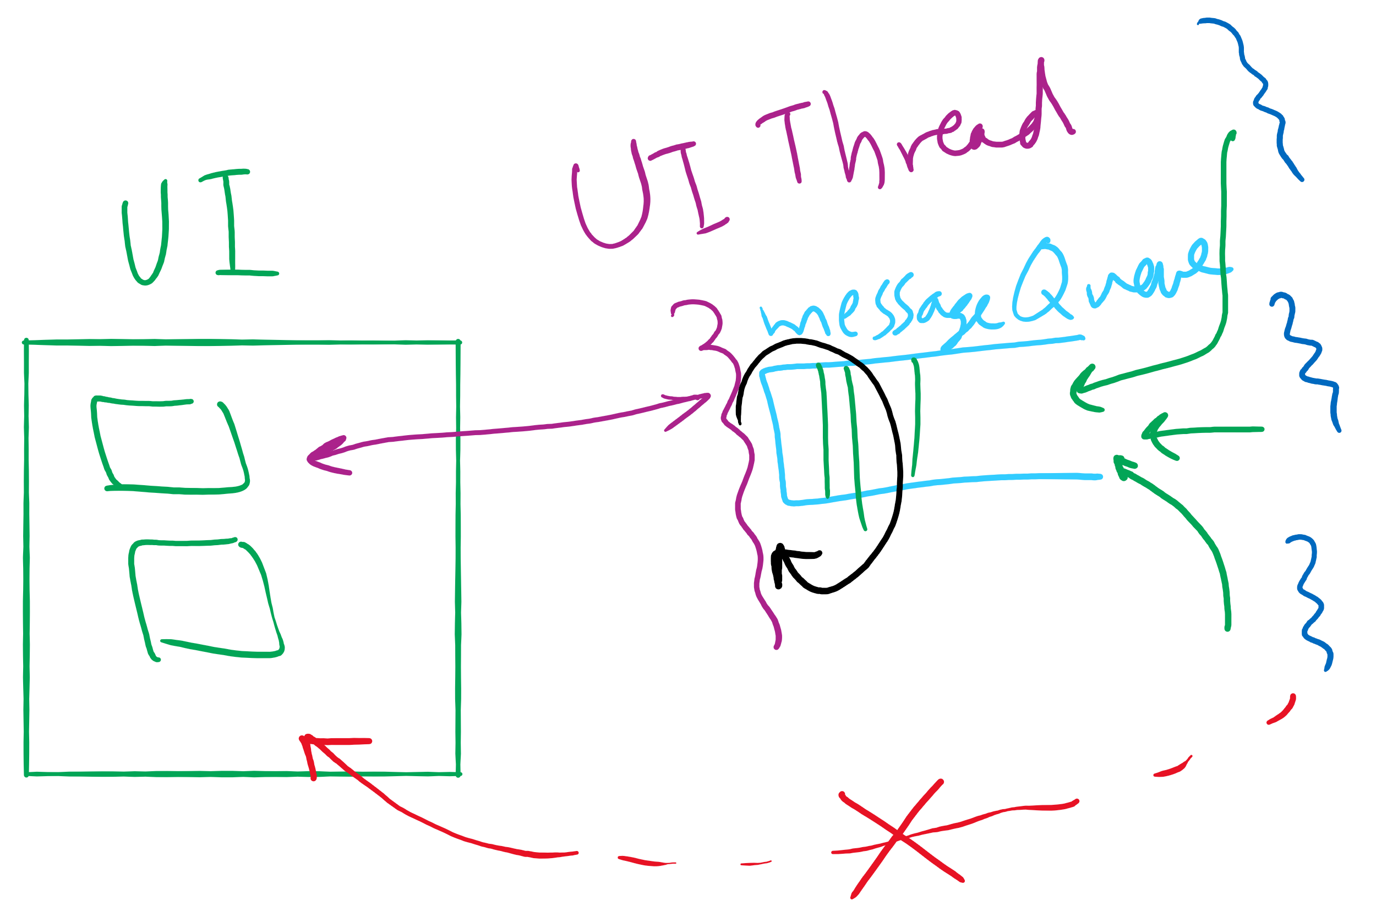
Message passing
Synchronize by exchanging messages
Two primitives:
Send: send a message
Receive: receive a message
Both may specify a “channel” to use
Issue: how does the sender know the receiver got the message?
Issue: authentication

Slide 37
Barriers
Used for synchronizing multiple processes
Processes wait at a “barrier” until all in the group arrive
After all have arrived, all processes can proceed
May be implemented using locks and condition variables
A
A
A
A
B
B
B
B
C
C
C
C
D
D
D
D
Processes approaching
barrier
B and D at
barrier
All at
barrier
Barrier releases all processes

Slide 38
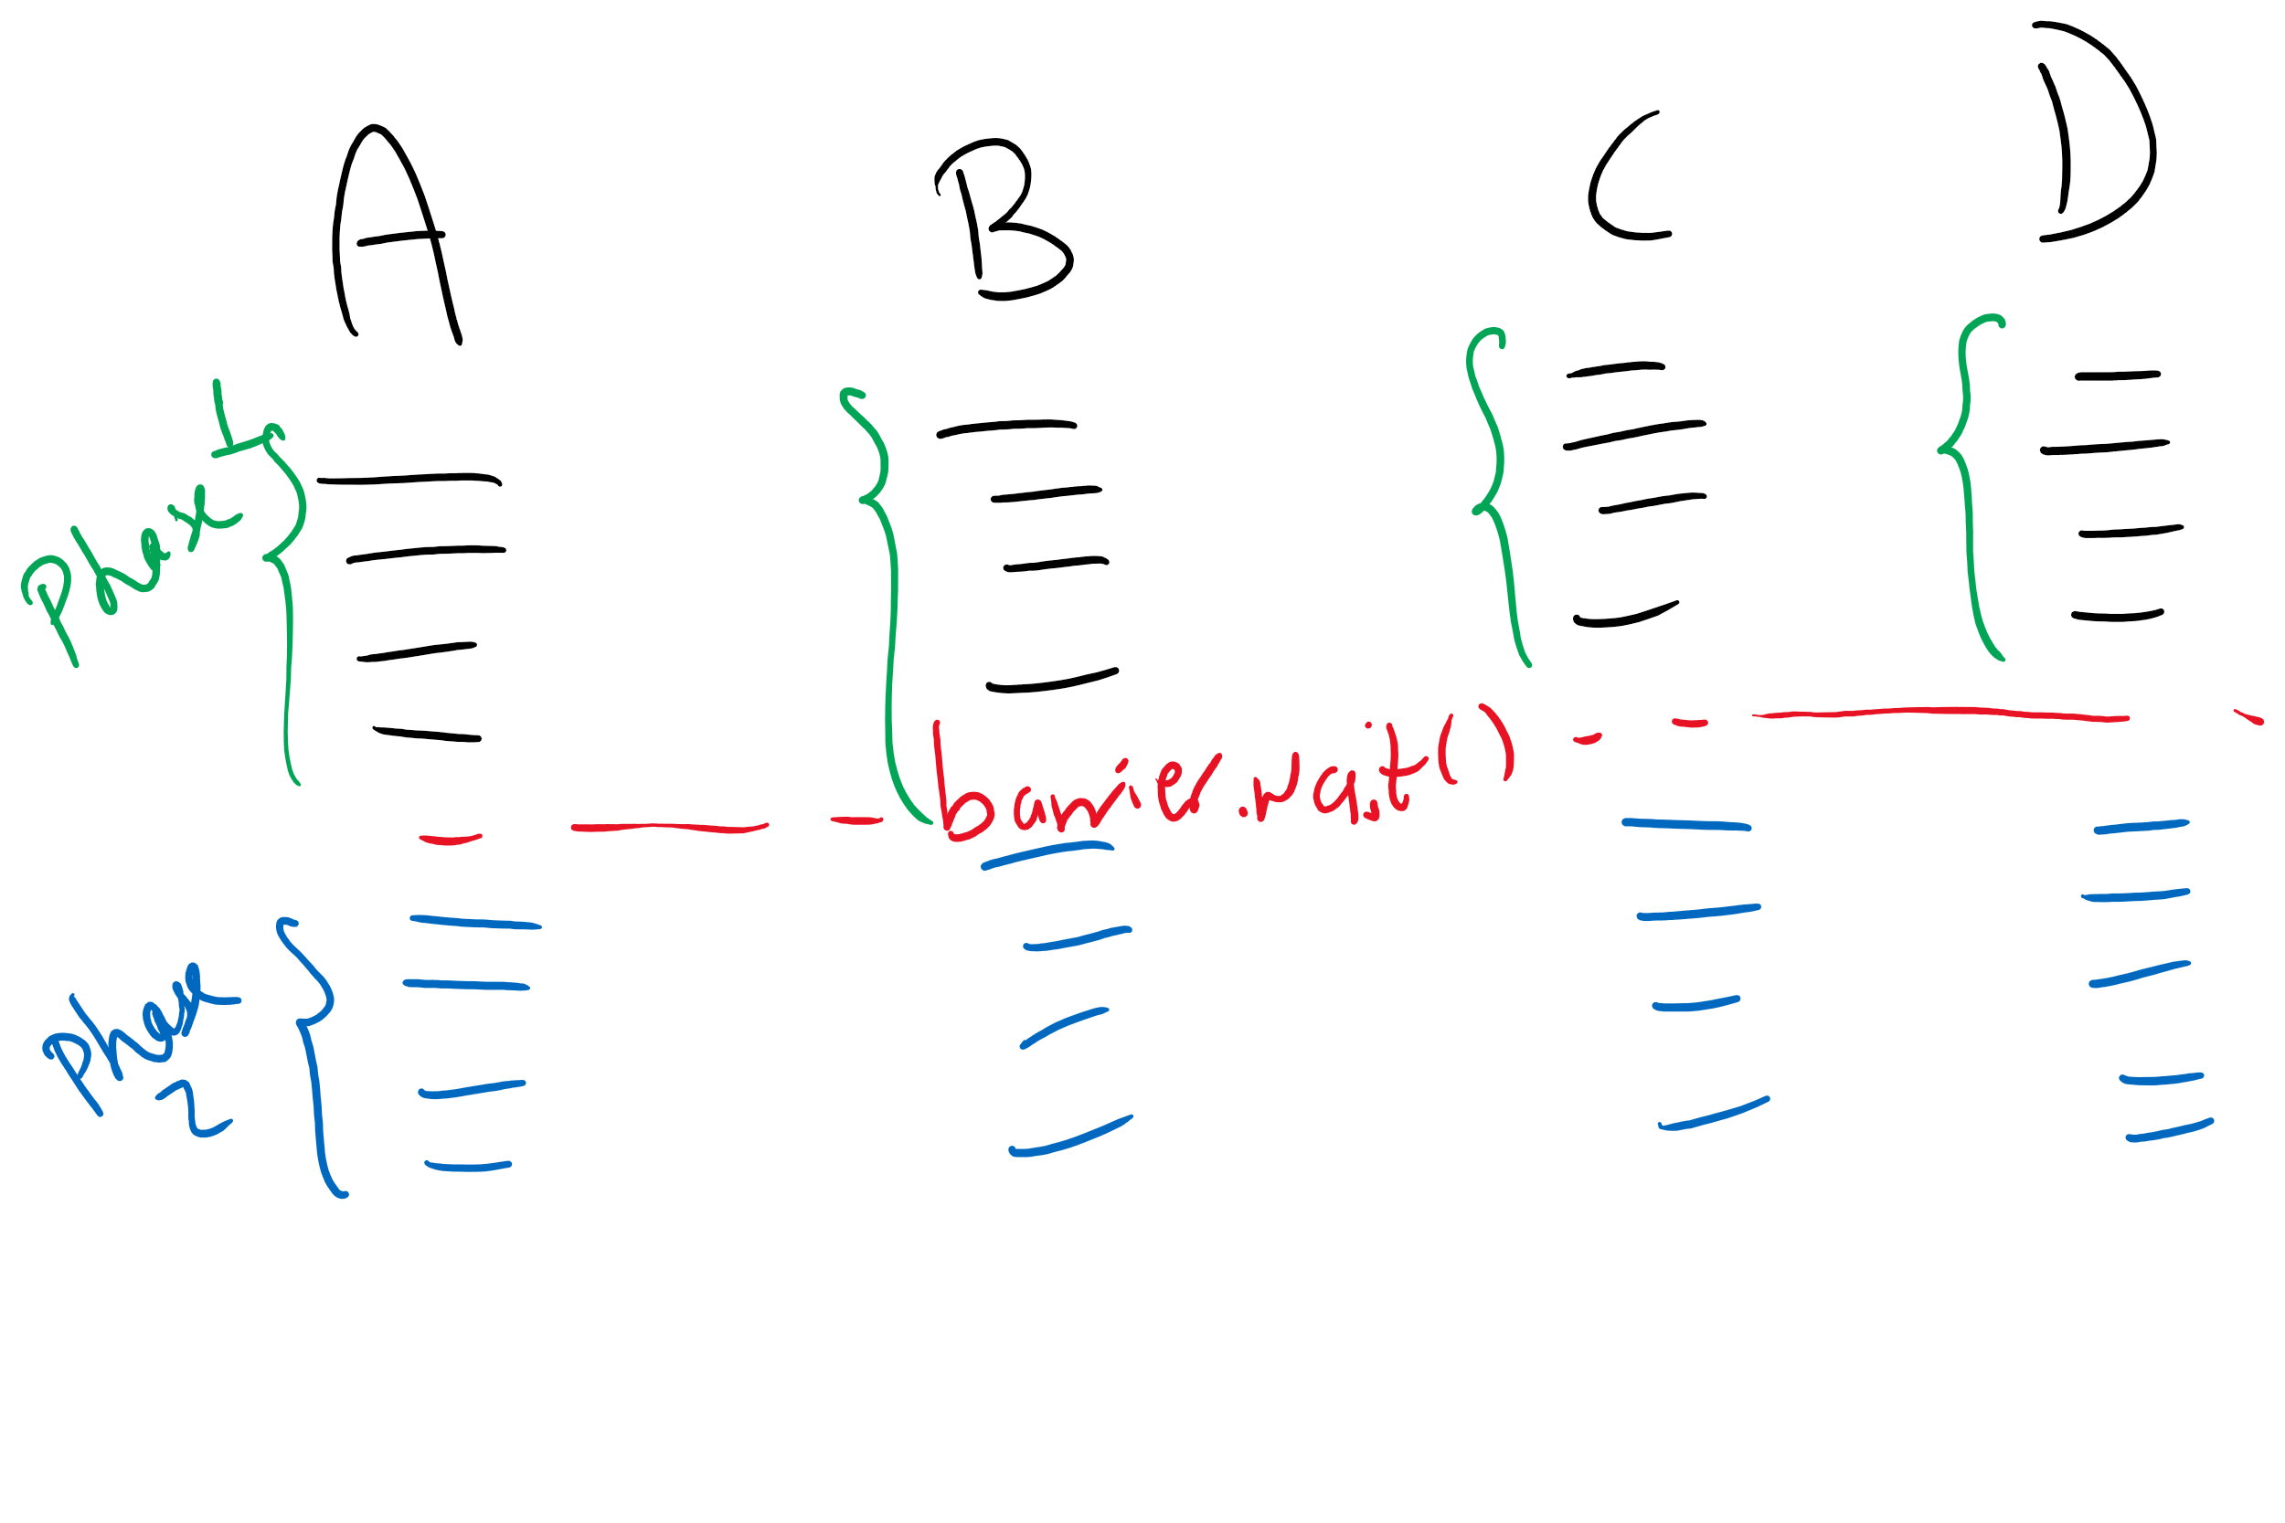
Barriers Example

Slide 39
Xv6 Walkthrough
sleep and wakeup

Slide 40
Classical synchronization problems
Bounded Buffer
Multiple producers and consumers
Synchronize access to shared buffer
Readers & Writers
Many processes that may read and/or write
Only one writer allowed at any time
Many readers allowed, but not while a process is writing
Dining Philosophers
Resource allocation problem
N processes and limited resources to perform sequence of tasks
Goal 1: use semaphores to implement solutions to these problems
Goal 2: use locks and condition variables to implement solutions to these problems

Slide 41
Bounded buffer problem
Goal: implement producer-consumer without busy waiting

Slide 42
Thread spawning

Slide 43
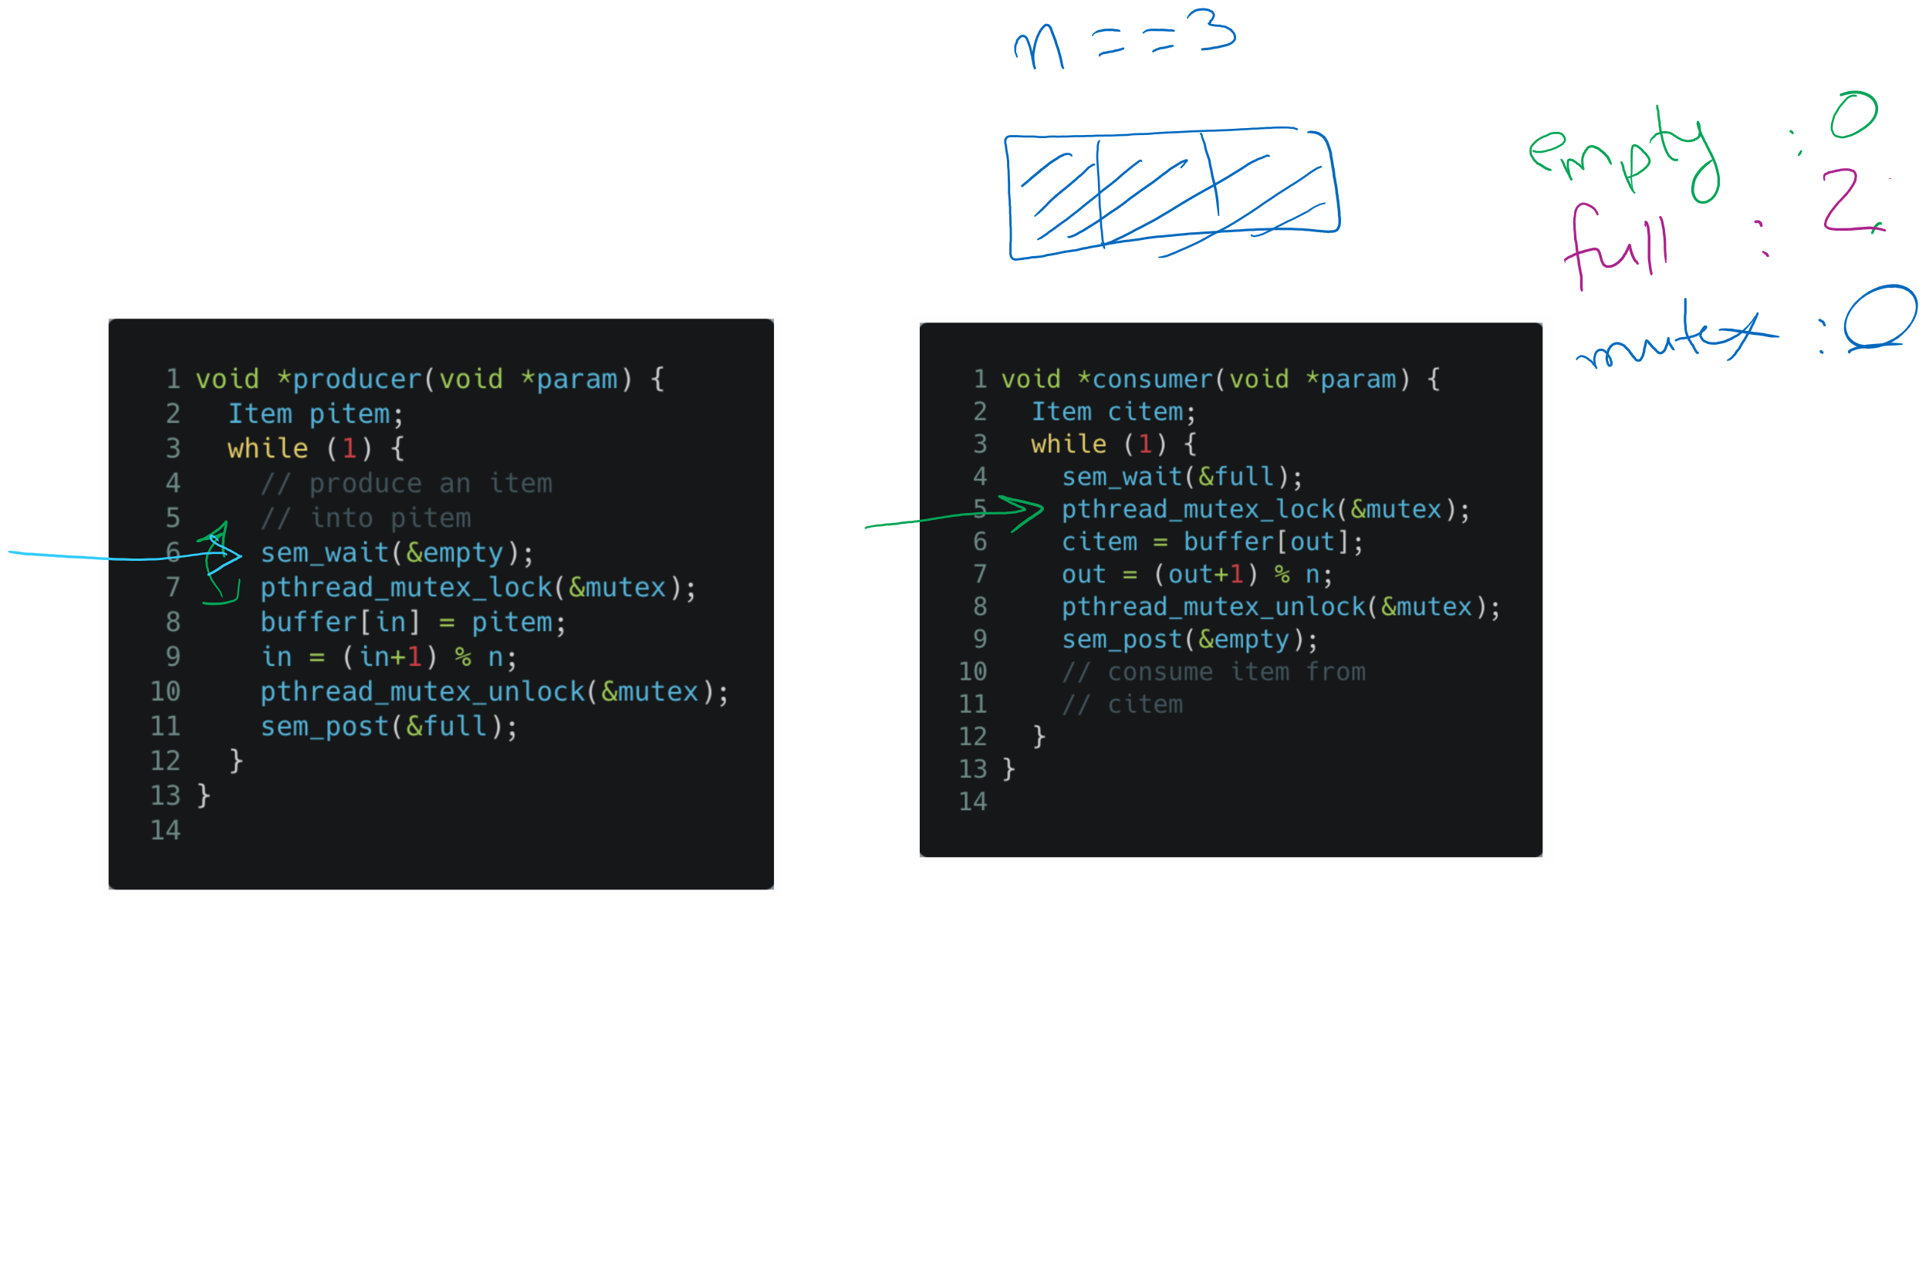
Tracing the solution

Slide 44
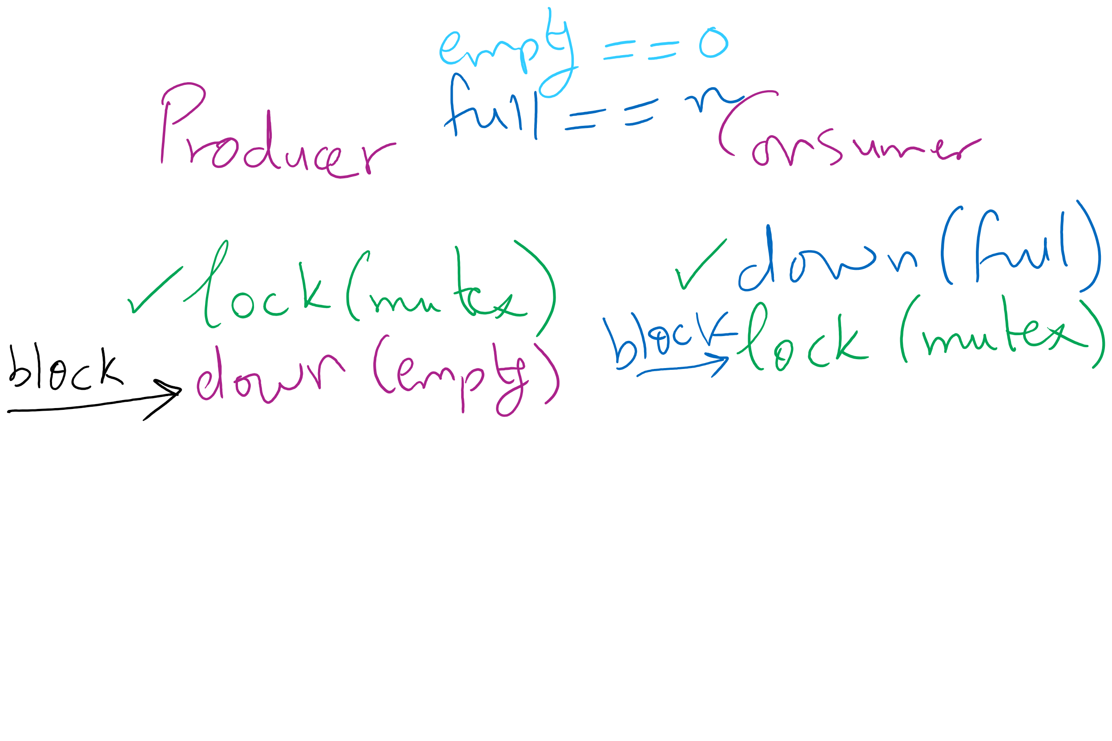
Deadlock can happen with a small mistake

Slide 45
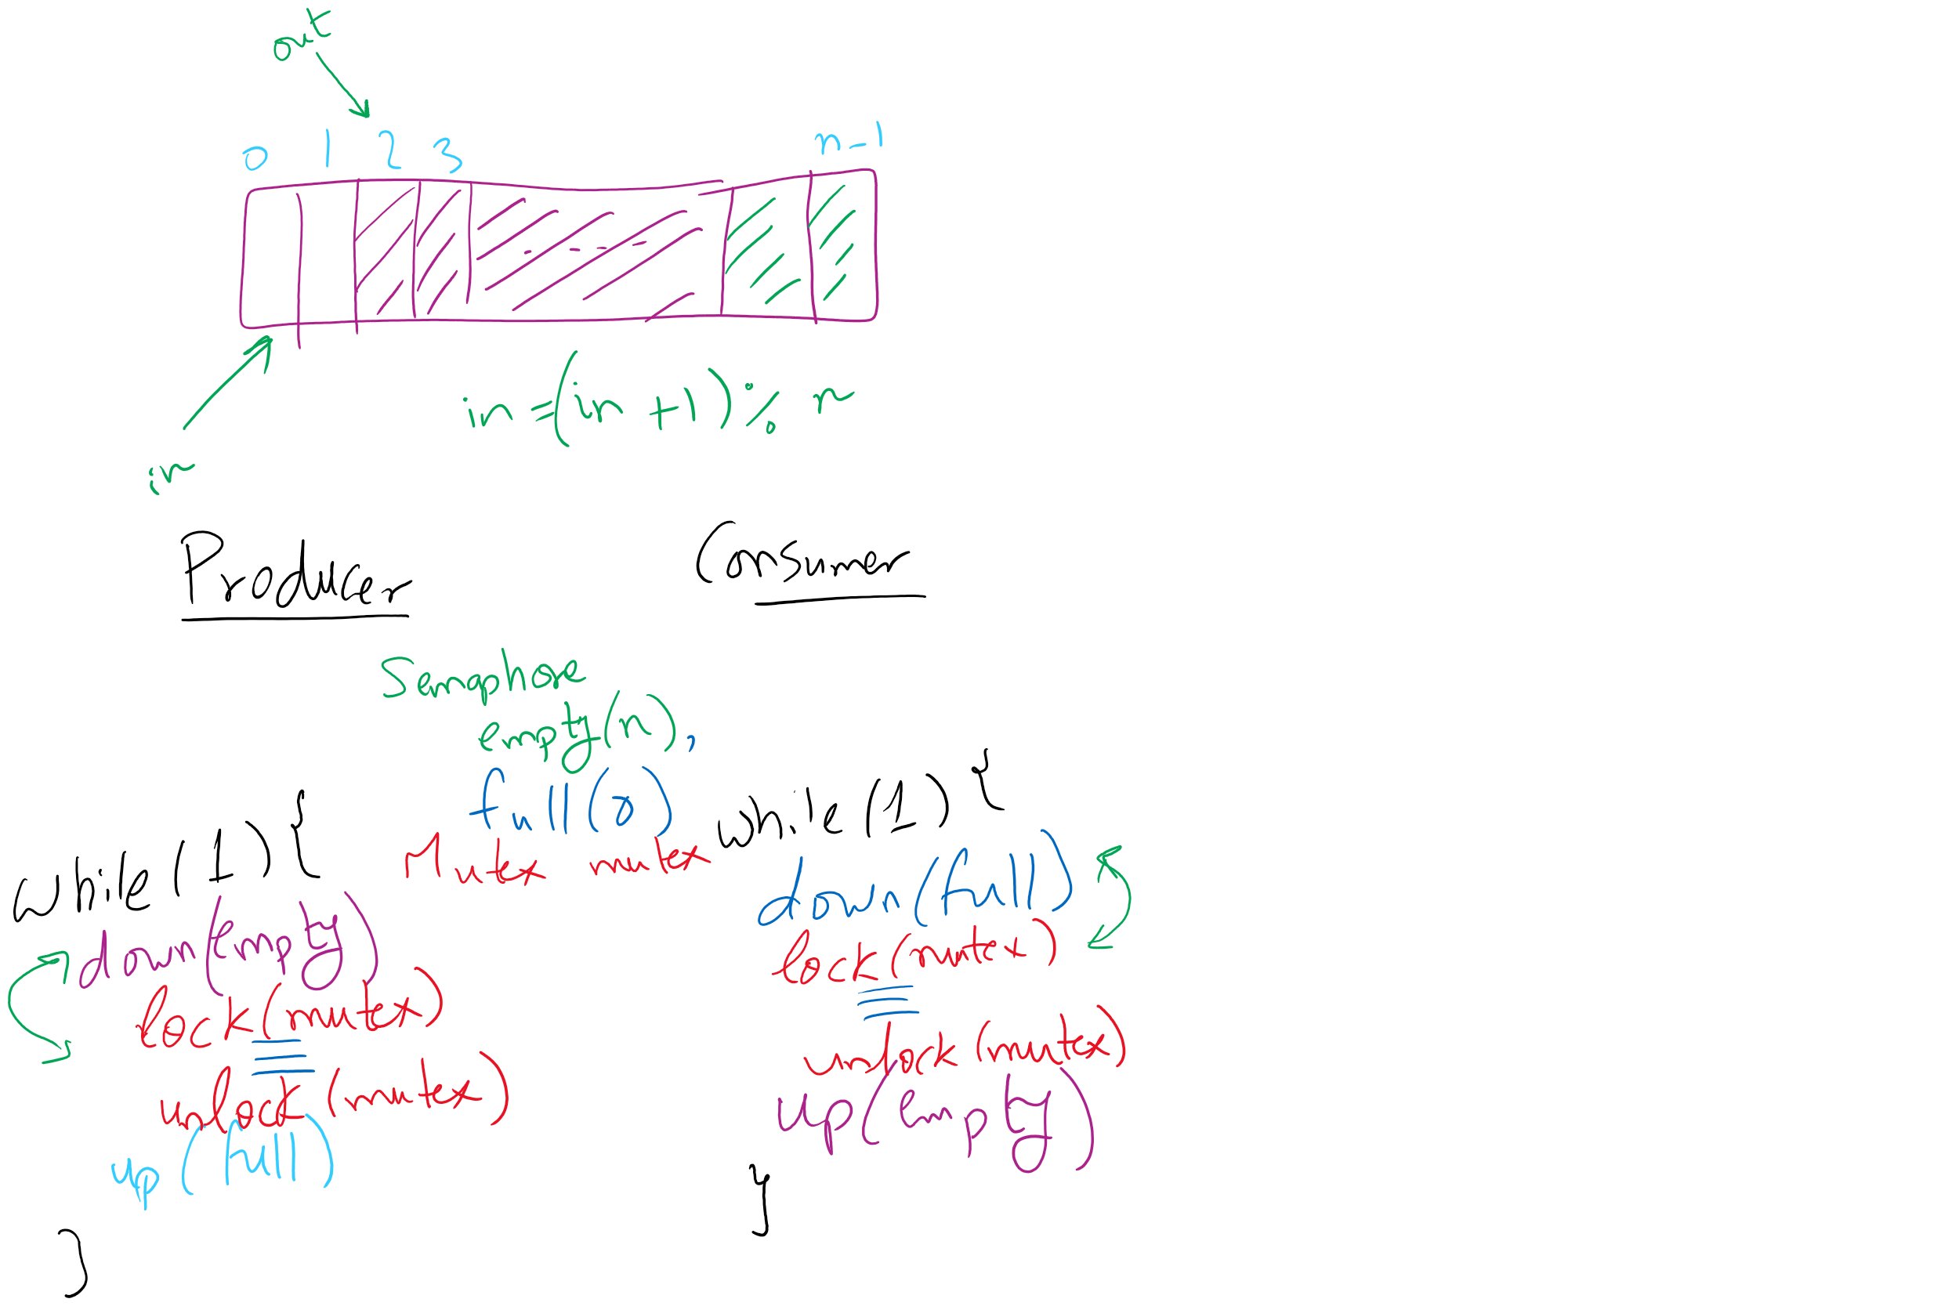
Bounded Buffer (Another rundown)

Slide 46
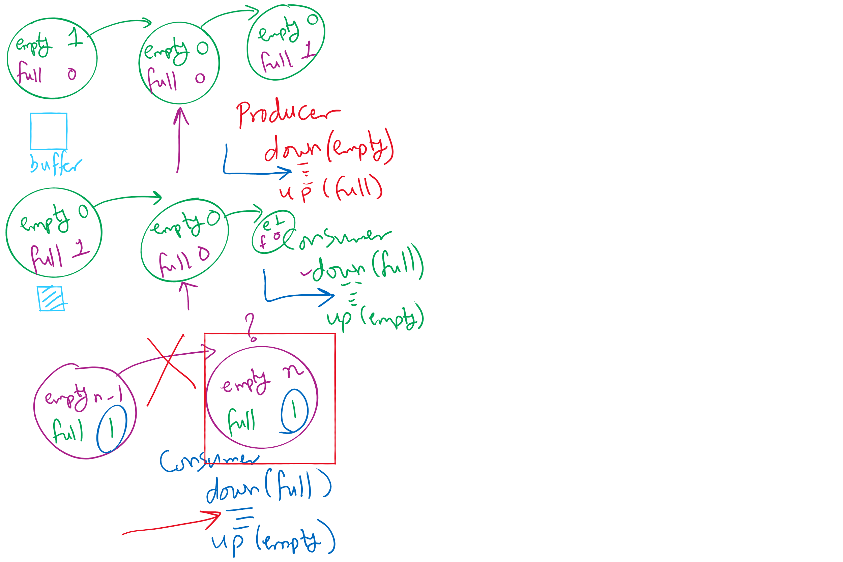
Possible states in Bounded Buffer Solution

Slide 47
Sequence 1
W0 enterWrite
W0 write
R0 enterRead
R1 enterRead
R2 enterRead
W0 doneWrite
R2 read
W1 enterWrite
R2 doneRead
W1 write
Reader process
…
mutex.down();
nreaders += 1;
if (nreaders == 1) // wait if
writing.down(); // 1st reader
mutex.up();
// Read some stuff
mutex.down();
nreaders -= 1;
if (nreaders == 0) // signal if
writing.up(); // last reader
mutex.up();
…
Writer process
…
writing.down();
// Write some stuff
writing.up();
…

Slide 48
Sequence 2
R0 enterRead
R0 read
R1 enterRead
R1 read
W0 enterWrite
R2 enterRead
R2 read
R2 doneRead
R1 doneRead
R0 doneRead
W0 write
W0 doneWrite
Reader process
…
mutex.down();
nreaders += 1;
if (nreaders == 1) // wait if
writing.down(); // 1st reader
mutex.up();
// Read some stuff
mutex.down();
nreaders -= 1;
if (nreaders == 0) // signal if
writing.up(); // last reader
mutex.up();
…
Writer process
…
writing.down();
// Write some stuff
writing.up();
…

Slide 49
What happens if we use if instead of while?
Consider the sequence:
W0 enterWrite
R0 enterRead
W1 write
W1 doneWrite
W0 enterWrite
W1 write
R0 read

Slide 50
Readers-writers problem
Shared variables
int nreaders;
Semaphore mutex(1), writing(1);
Reader process
…
mutex.down();
nreaders += 1;
if (nreaders == 1) // wait if
writing.down(); // 1st reader
mutex.up();
// Read some stuff
mutex.down();
nreaders -= 1;
if (nreaders == 0) // signal if
writing.up(); // last reader
mutex.up();
…
Writer process
…
writing.down();
// Write some stuff
writing.up();
…

Slide 51
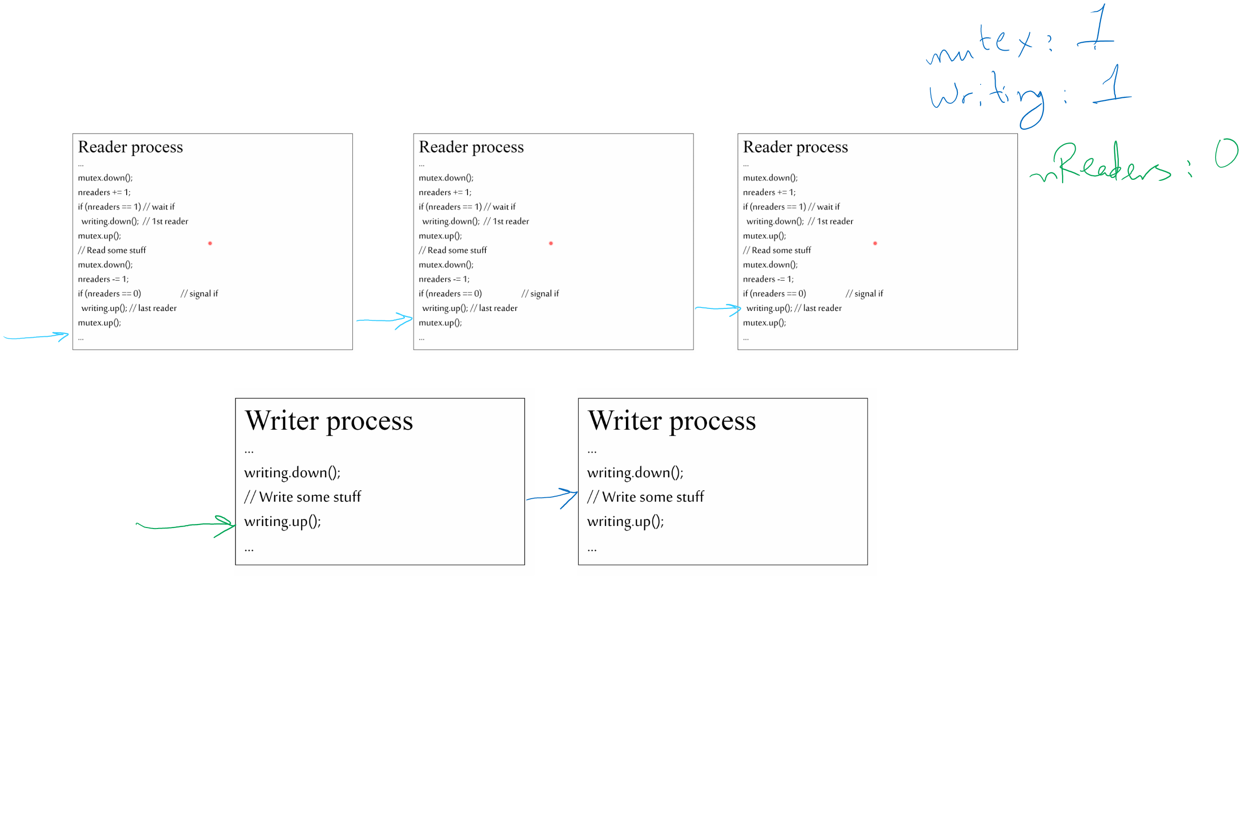
Tracing the solution

Slide 52
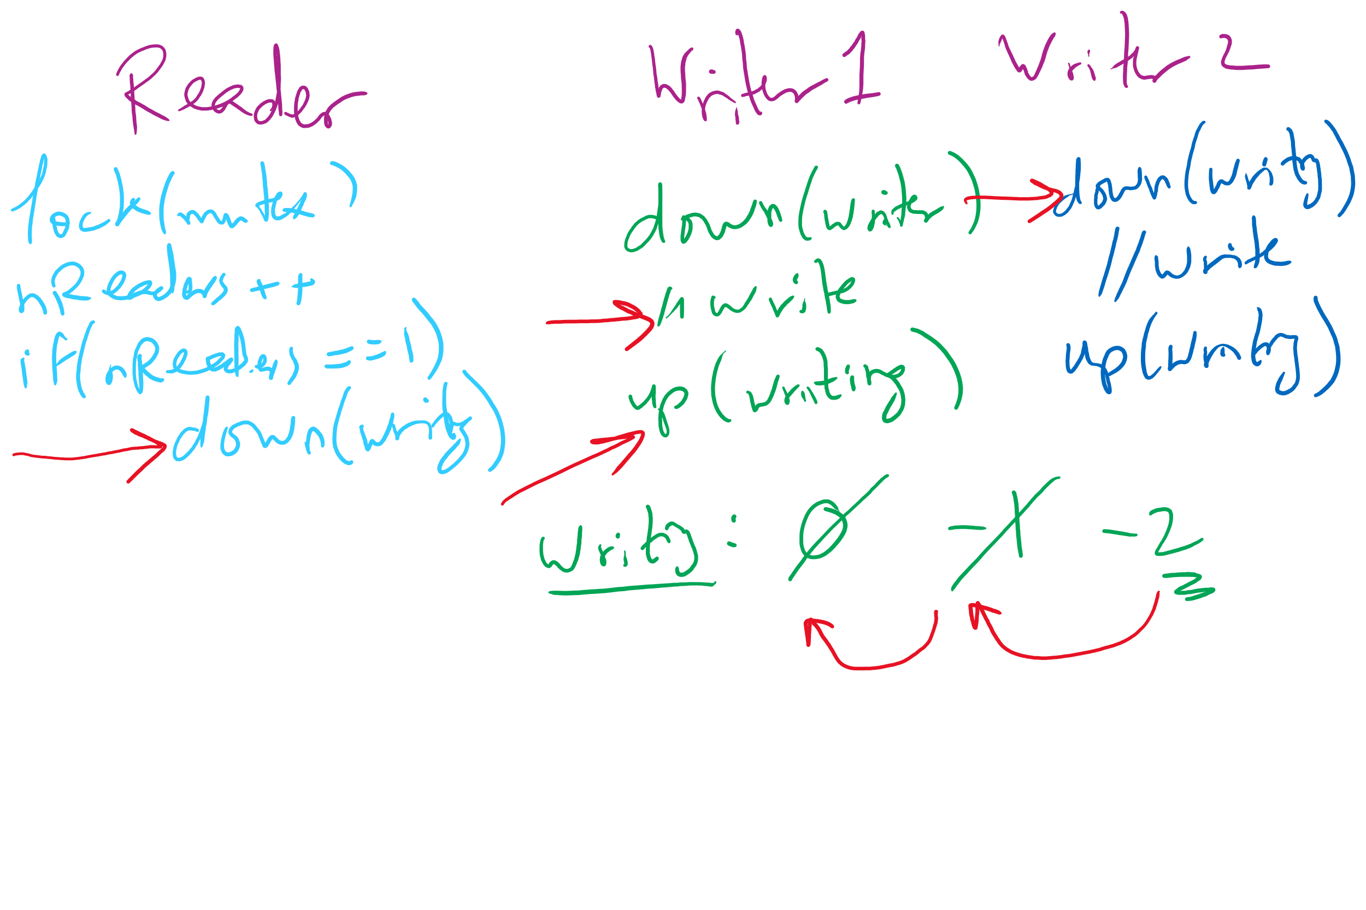
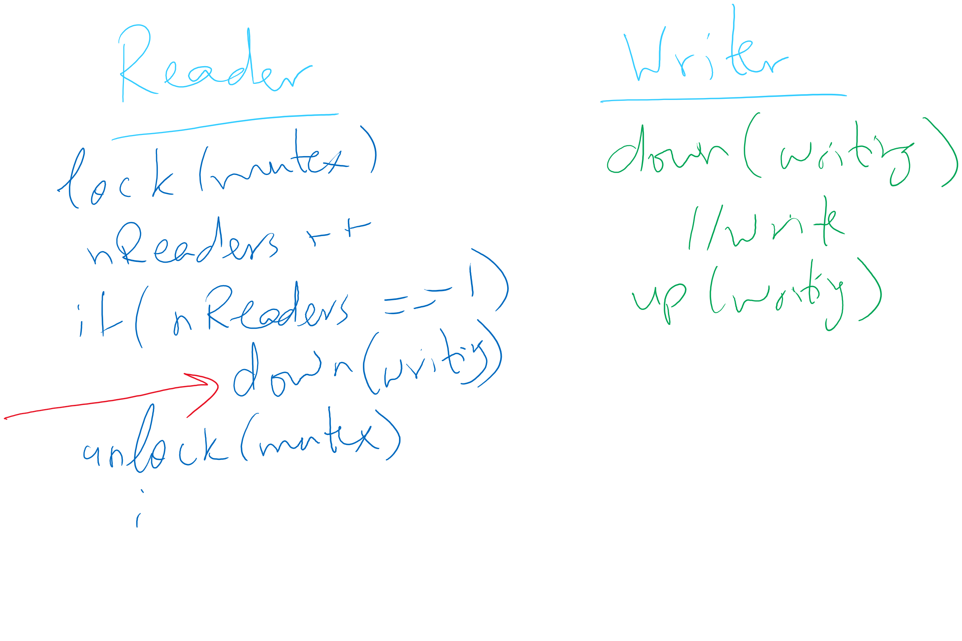
Readers Writers Scenarios

Slide 53


Dining Philosophers
N philosophers around a table
All are hungry
All like to think
N chopsticks available
1 between each pair of philosophers
Philosophers need two chopsticks to eat
Philosophers alternate between eating and thinking
Goal: coordinate use of chopsticks

Slide 54
Dining Philosophers: solution 1
Use a semaphore for each chopstick
A hungry philosopher
Gets the chopstick to his right
Gets the chopstick to his left
Eats
Puts down the chopsticks
Potential problems?
Deadlock
Fairness
Shared variables
const int n;
// initialize to 1
Semaphore chopstick[n];
Code for philosopher i
while(1) {
chopstick[i].down();
chopstick[(i+1)%n].down();
// eat
chopstick[i].up();
chopstick[(i+1)%n].up();
// think
}

Slide 55
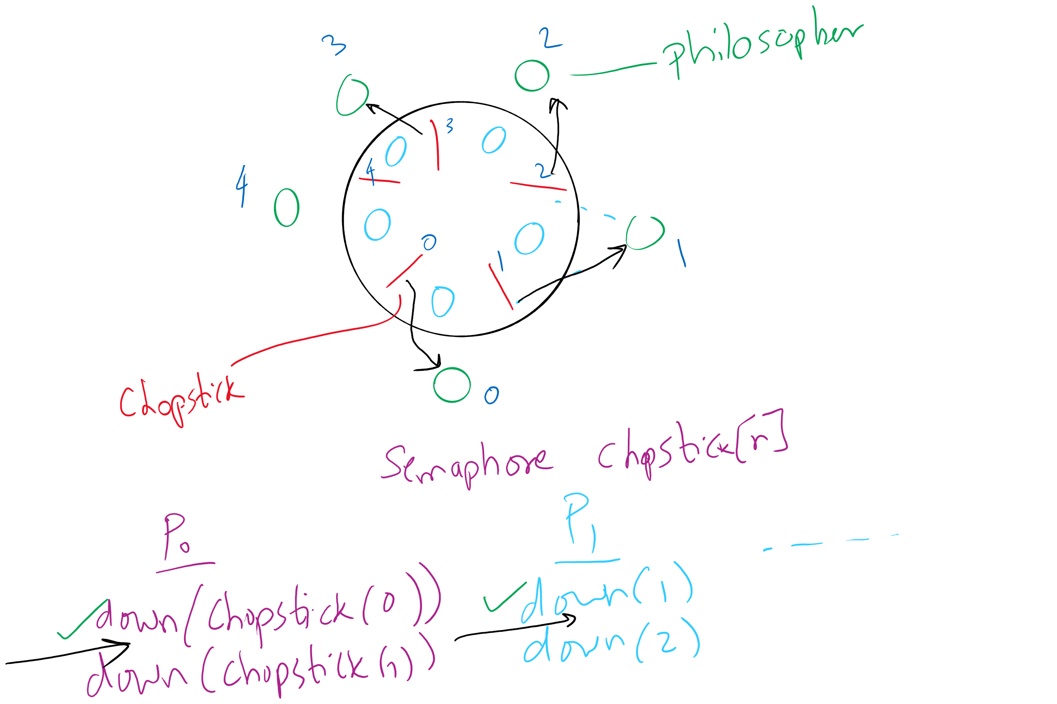
Deadlock in the first (incorrect) solution of Dining Philosophers

Slide 56
Dining Philosophers: solution 2
Use a semaphore for each chopstick
A hungry philosopher
Gets lower, then higher numbered chopstick
Eats
Puts down the chopsticks
Potential problems?
Deadlock
Fairness
Code for philosopher i
int i1,i2;
while(1) {
if (i != (n-1)) {
i1 = i;
i2 = i+1;
} else {
i1 = 0;
i2 = n-1;
}
chopstick[i1].down();
chopstick[i2].down();
// eat
chopstick[i1].up();
chopstick[i2].up();
// think
}
Shared variables
const int n;
// initialize to 1
Semaphore chopstick[n];

Slide 57
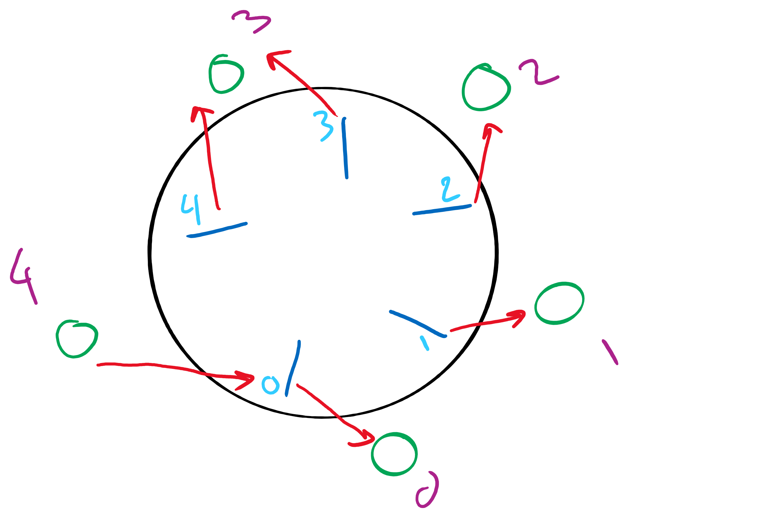
Dining Philosophers Solution

Slide 58
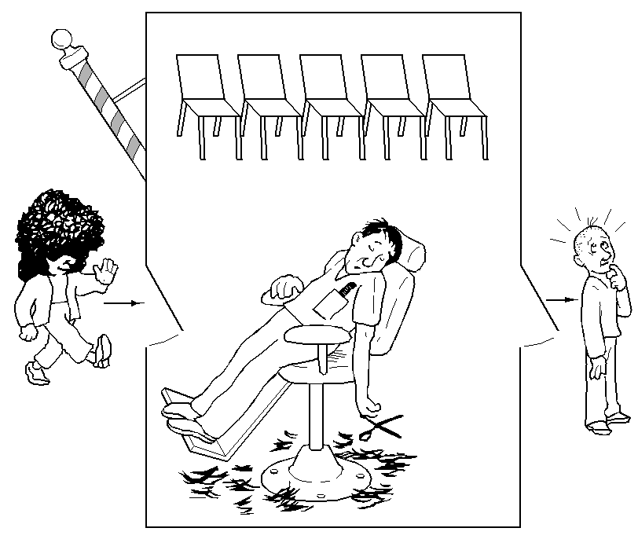
The Sleepy Barber Problem

Slide 59
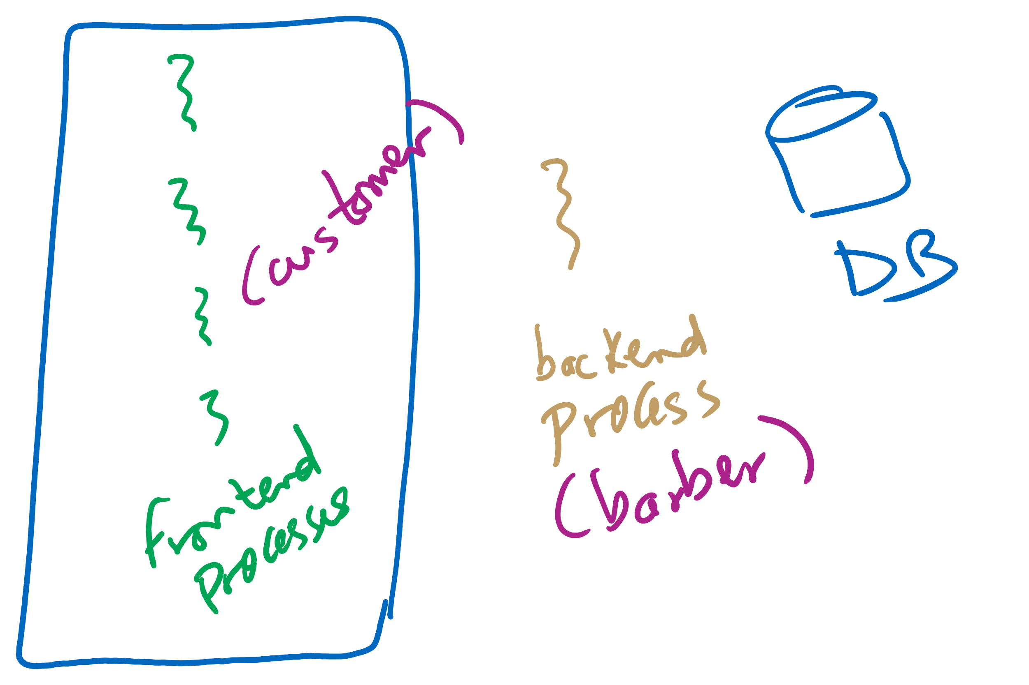
Sleepy Barber Real-life Example

Slide 60
Code for the Sleepy Barber Problem
#define CHAIRS 5
Semaphore customers=0;
Semaphore barbers=0;
Semaphore mutex=1;
int waiting=0;
void barber(void)
{
while(TRUE) {
// Sleep if no customers
customers.down();
// Decrement # of waiting people
mutex.down();
waiting -= 1;
// Wake up a customer to cut hair
barbers.up();
mutex.up();
// Do the haircut
cut_hair();
}
}
void customer(void)
{
mutex.down();
// If there is space in the chairs
if (waiting<CHAIRS) {
// Another customer is waiting
waiting++;
// Wake up the barber. This is
// saved up, so the barber doesn’t
// sleep if a customer is waiting
customers.up();
mutex.up();
// Sleep until the barber is ready
barbers.down();
get_haircut();
} else {
// Chairs full, leave the critical
// region
mutex.up ();
}
}

